Slide 1
Netrin-1 RNA-seq
Group Meeting Results Update
Primary rat cortical cultures | DIV1 / DIV2 / DIV2 + Netrin-1 | bulk RNA-seq
25
481 / 42
1,495
strict Netrin-responsive DEGs
GO BP / KEGG GSEA terms
strict developmental DEGs
June 17, 2026
Notes:
开场：这是一版组会 result update，不是完整答辩。重点讲目前 RNA-seq 分析已经完成到哪里、最关键结果是什么、以及下一步实验/分析怎么推进。

Slide 2
STATUS
What is now complete?
The main Netrin contrast, developmental context, and cell-source interpretation are all ready for discussion.
Completed result blocks
Main interpretation
QC / PCA; C1 Netrin vs DIV2 DEG + GSEA; C2 DIV2 vs DIV1 DEG + ORA + GSEA; heatmaps; cell-type marker analysis.
Netrin-1 produces a focused bidirectional response: synapse / axon-guidance programs rise while cell-cycle / progenitor programs fall.
Key caveat
Bulk mixed culture means top single-gene hits must be interpreted with cell-source guardrails, especially microglia and oligodendrocyte markers.
Netrin-1 RNA-seq result update
02
Notes:
状态页。直接告诉大家：这次不是还在做 QC，而是主结果已经形成。要讨论的不是有没有信号，而是如何解释这个信号，尤其是 bulk mixed culture 的细胞来源问题。

Slide 3
STUDY SETUP
Two contrasts answer two different questions.
C1 is the treatment result; C2 provides developmental scale and context.
DIV1
DIV2
DIV2 + Netrin-1
n=3
n=3
n=3
C1: Netrin effect
C2: 24 h development
DIV2 + Netrin-1 vs DIV2
Primary biological question.
DIV2 vs DIV1
Scale and composition context.
DESeq2 model: ~ batch + condition; batch correction only for visualization.
Netrin-1 RNA-seq result update
03
Notes:
设计页。C1 是 Netrin treatment effect；C2 是 DIV1 到 DIV2 的 24 小时发育/vehicle 背景。统计模型里 batch 作为协变量，校正矩阵只用作 PCA 和 heatmap 可视化。

Slide 4
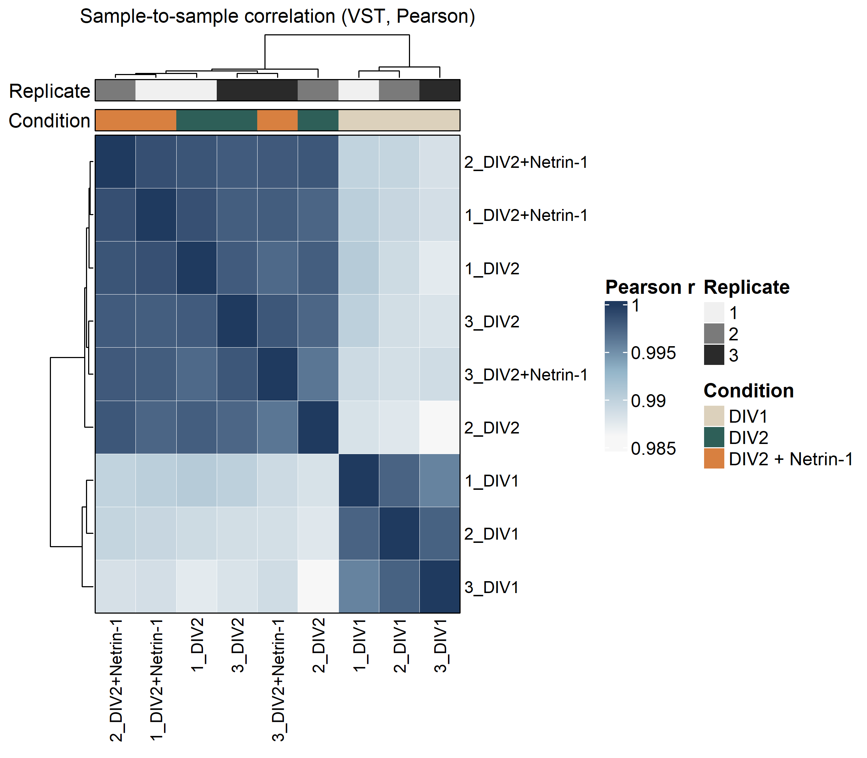
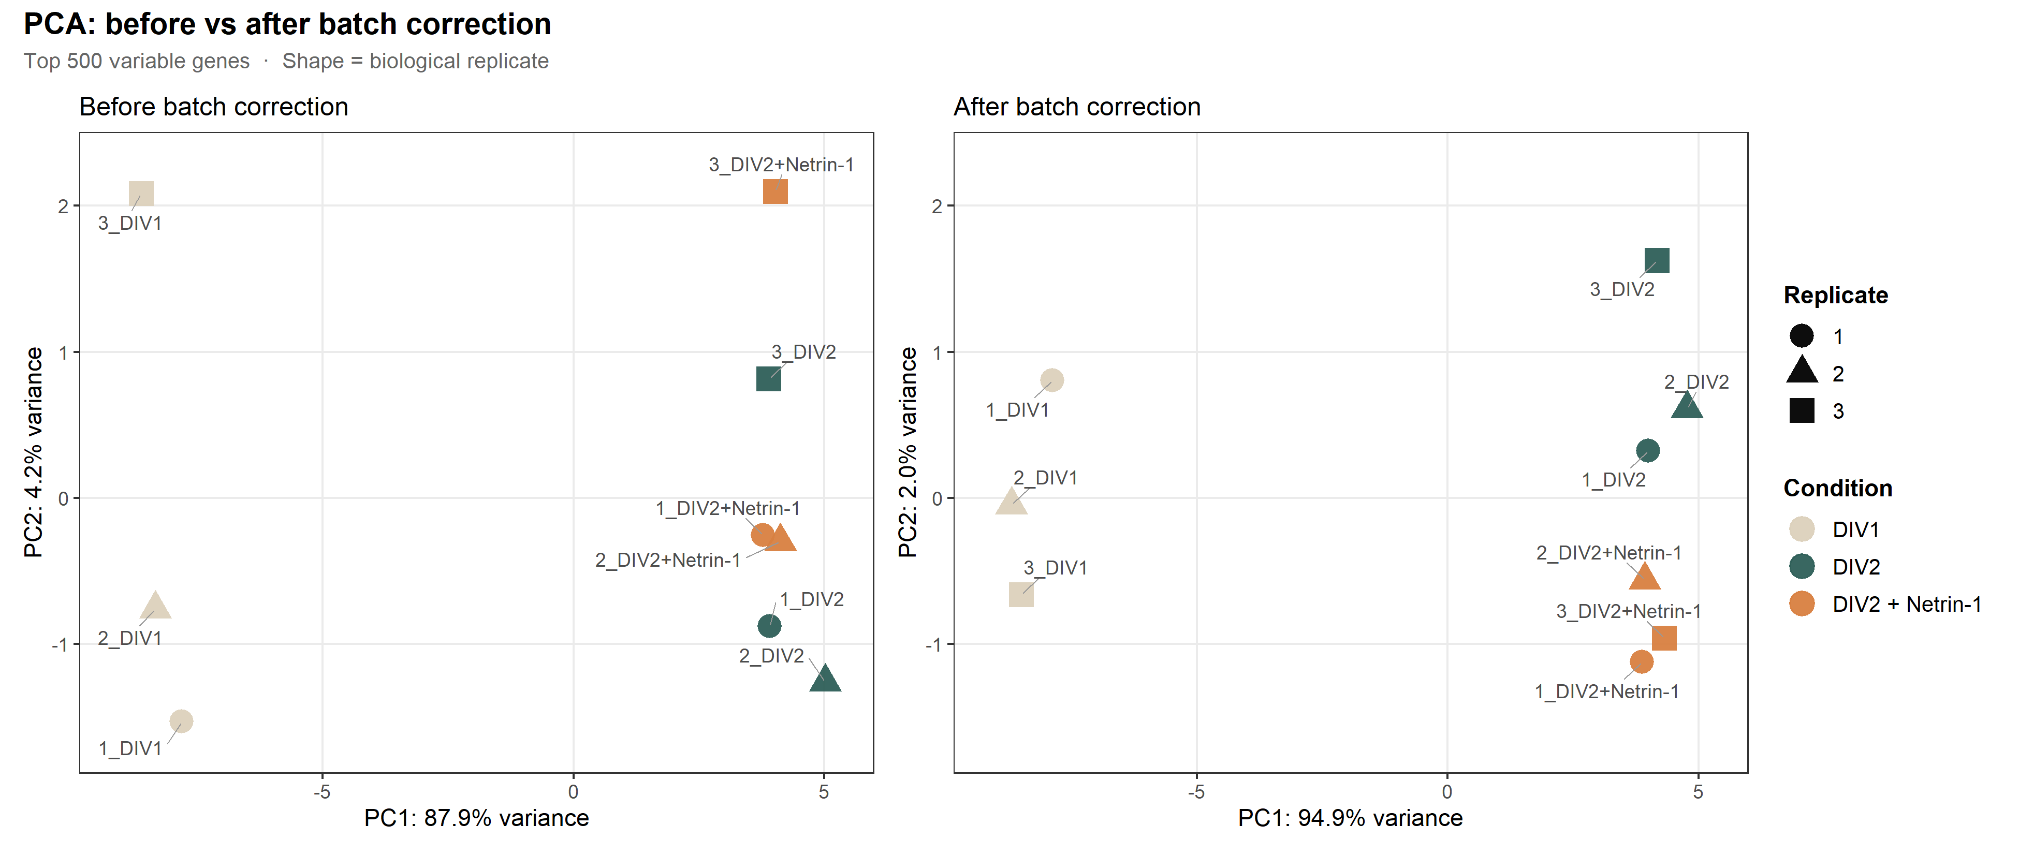
QC
The dataset is clean enough for contrast-level interpretation.
High sample correlation and PCA separation support downstream analysis.
r = 0.9861-0.9987; no sample outliers
After visual batch correction, Netrin separates on PC2
Netrin-1 RNA-seq result update
04
Notes:
QC 只讲结论：样本相关性高，没有 outlier；PCA 校正后能看到 DIV2 与 DIV2+Netrin 在 PC2 分开，说明主对比有可见信号。

Slide 5
RESULT 1
Netrin-1 response is focused and bidirectional.
Primary contrast: DIV2 + Netrin-1 vs DIV2 control.
05
Notes:
过渡页。下面进入 C1 主结果。

Slide 6
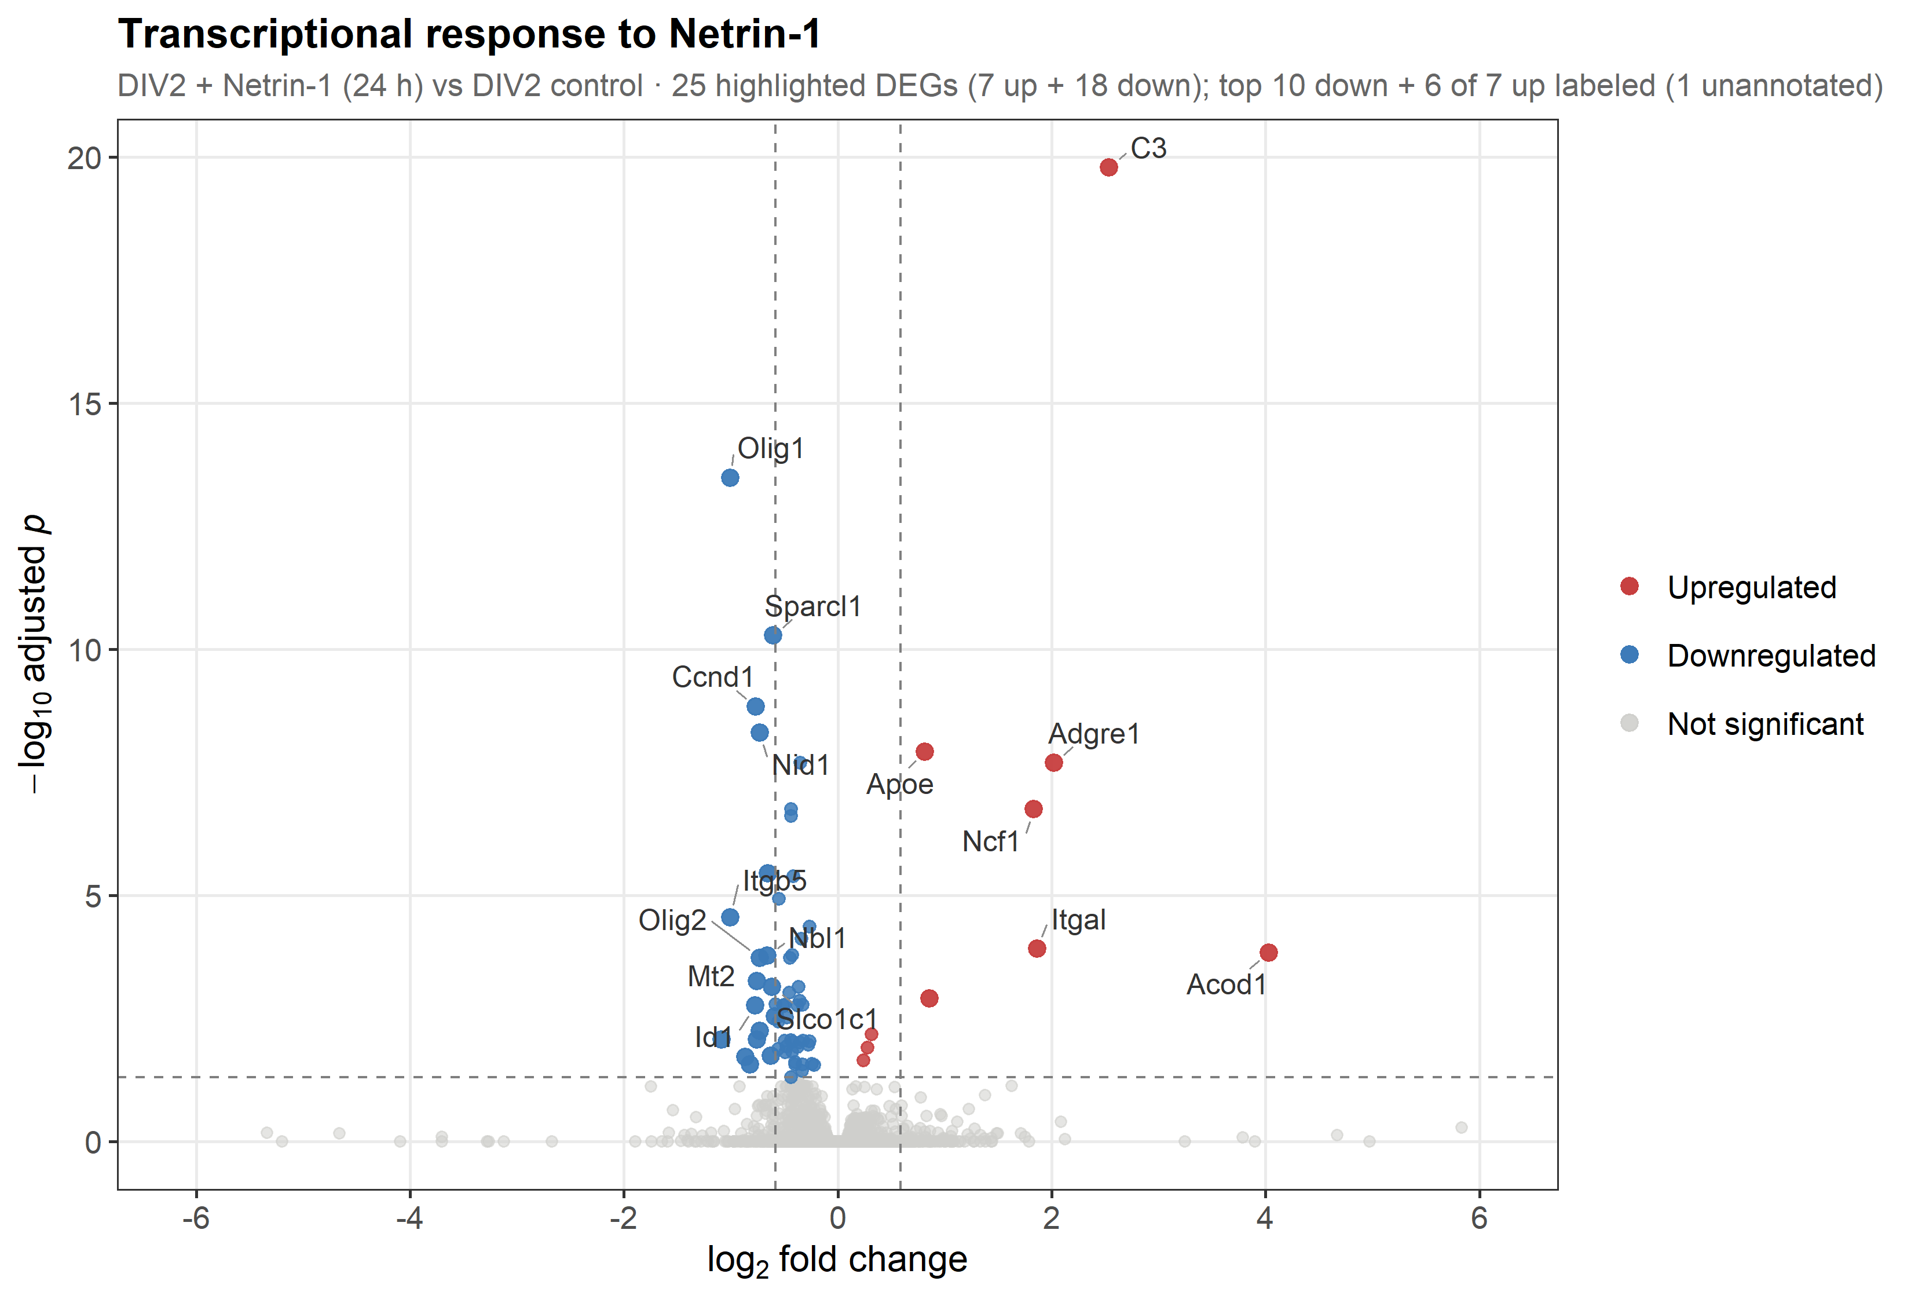
C1 DEG
Netrin-1 changes a small, high-confidence gene set.
Strict DEG threshold: padj < 0.05 and |LFC| > 0.585.
25
7 up / 18 down
strict DEGs
direction
66
relaxed DEGs
Top up: C3 (+2.54, padj 1.6e-20)
Top down: Olig1 (-1.00, padj 3.3e-14)
Netrin-1 RNA-seq result update
06
Notes:
火山图：C1 的 DEG 数量不大，STRICT 只有 25 个，7 上调 18 下调；RELAXED 66 个。结论是 focused response，不是全转录组大重塑。

Slide 7
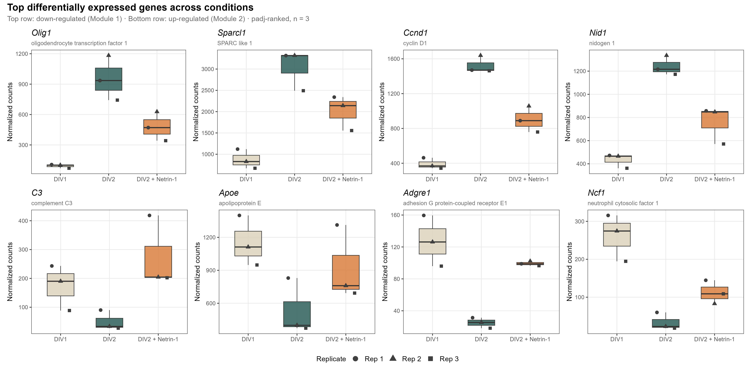
C1 SINGLE GENES
The strongest genes are biologically informative, but not all neuron-intrinsic.
This is where cell-source interpretation becomes necessary.
Up module
C3, Apoe, Adgre1, Ncf1, Itgal, Acod1
Immune / microglial signature.
Down module
Olig1, Olig2, Sparcl1, Ccnd1, Id1/3
OPC / glial / progenitor-linked signature.
Netrin-1 RNA-seq result update
07
Notes:
这页讲单基因模块。免疫相关基因上调，Olig/progenitor/glial 相关基因下调。重点提醒：这些 top gene 不是全都神经元内在信号，所以后面必须用 GSEA 和 marker 分析来归因。

Slide 8
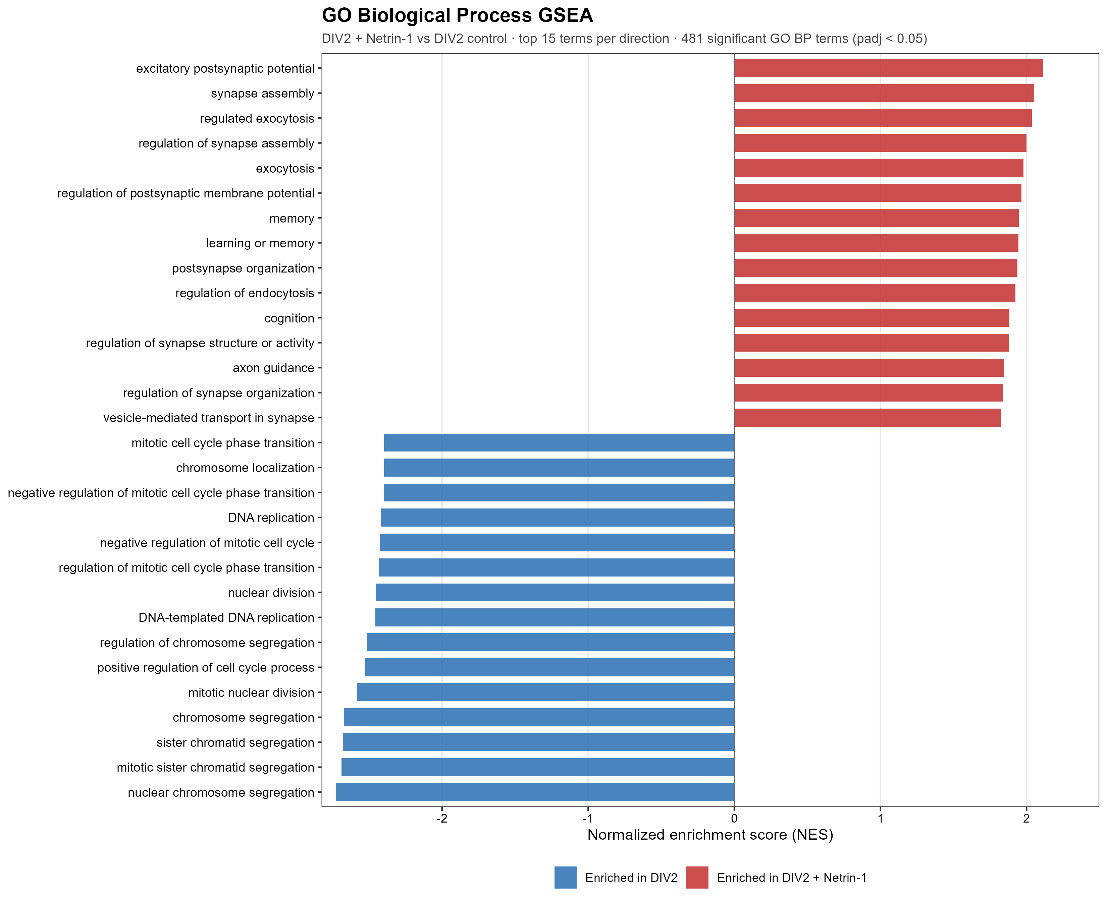
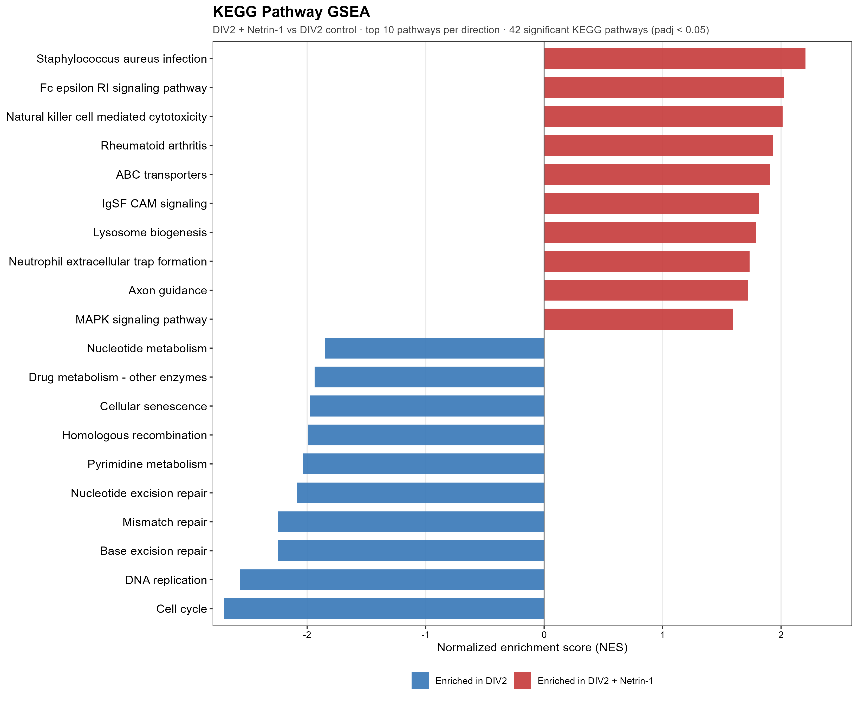
C1 GSEA
Gene-set analysis reveals the neuronal program beneath the top genes.
Synaptic and axon-guidance programs rise; cell-cycle programs fall.
GO BP: 481 significant terms (255 activated / 226 suppressed)
KEGG: 42 significant pathways (20 activated / 22 suppressed)
Netrin-1 RNA-seq result update
08
Notes:
GSEA 是主结论。虽然单个 DEG 不多，但全排序显示突触、axon guidance、exocytosis、learning/memory 上调；cell cycle、DNA replication、chromosome segregation 下调。

Slide 9
C1 MECHANISM
Two modules explain the response.
The result is bidirectional tuning, not simple maturation acceleration.
Activated
Suppressed
Synapse / axon guidance
Cell cycle / progenitor
GO axon guidance NES +1.85
KEGG axon guidance NES +1.72
Synapse assembly NES +2.05
KEGG Cell cycle NES -2.70
DNA replication / repair suppressed
Olig1/Olig2/Ccnd1 down
Interpretation
Netrin-1 appears to coordinate subtle neuronal pathway activation while suppressing proliferative/progenitor-associated programs.
Netrin-1 RNA-seq result update
09
Notes:
模型页：把 C1 解释成 two-module response。上调端是神经元功能通路，尤其 axon guidance 跨 GO/KEGG 收敛；下调端是 cell cycle/progenitor。不要说简单加速成熟，要说 bidirectional tuning。

Slide 10
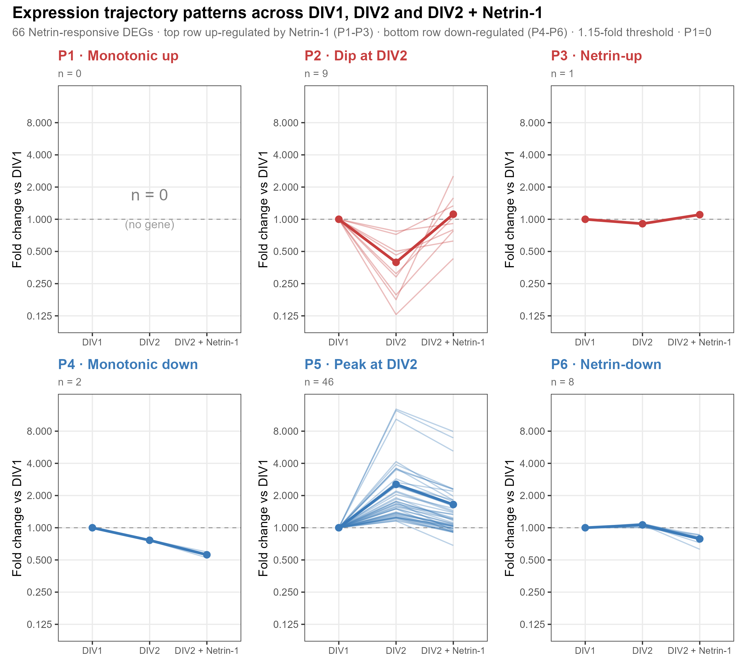
C1 PATTERN CHECK
Trajectory patterns argue against a simple acceleration story.
P1 monotonic-up genes are absent; the dominant pattern reflects DIV2 peak then Netrin reversal.
P5 = 46
peak at DIV2
P1 = 0
monotonic acceleration genes
Important: Olig1/Olig2 are glial-lineage markers; P5 should not be over-read as neuron-intrinsic maturation.
Netrin-1 RNA-seq result update
10
Notes:
Pattern 页强调阴性结果：P1=0，没有基因沿 DIV1→DIV2→Netrin 单调上升。P5 最大，但 Olig1/Olig2 是胶质/OPC marker，所以不能直接说神经元成熟被加速。

Slide 11
RESULT 2
The 24 h developmental contrast gives scale and context.
Secondary contrast: DIV2 vs DIV1.
11
Notes:
进入 C2。C2 不是主问题，但帮助理解 24 小时背景和细胞组成变化。

Slide 12
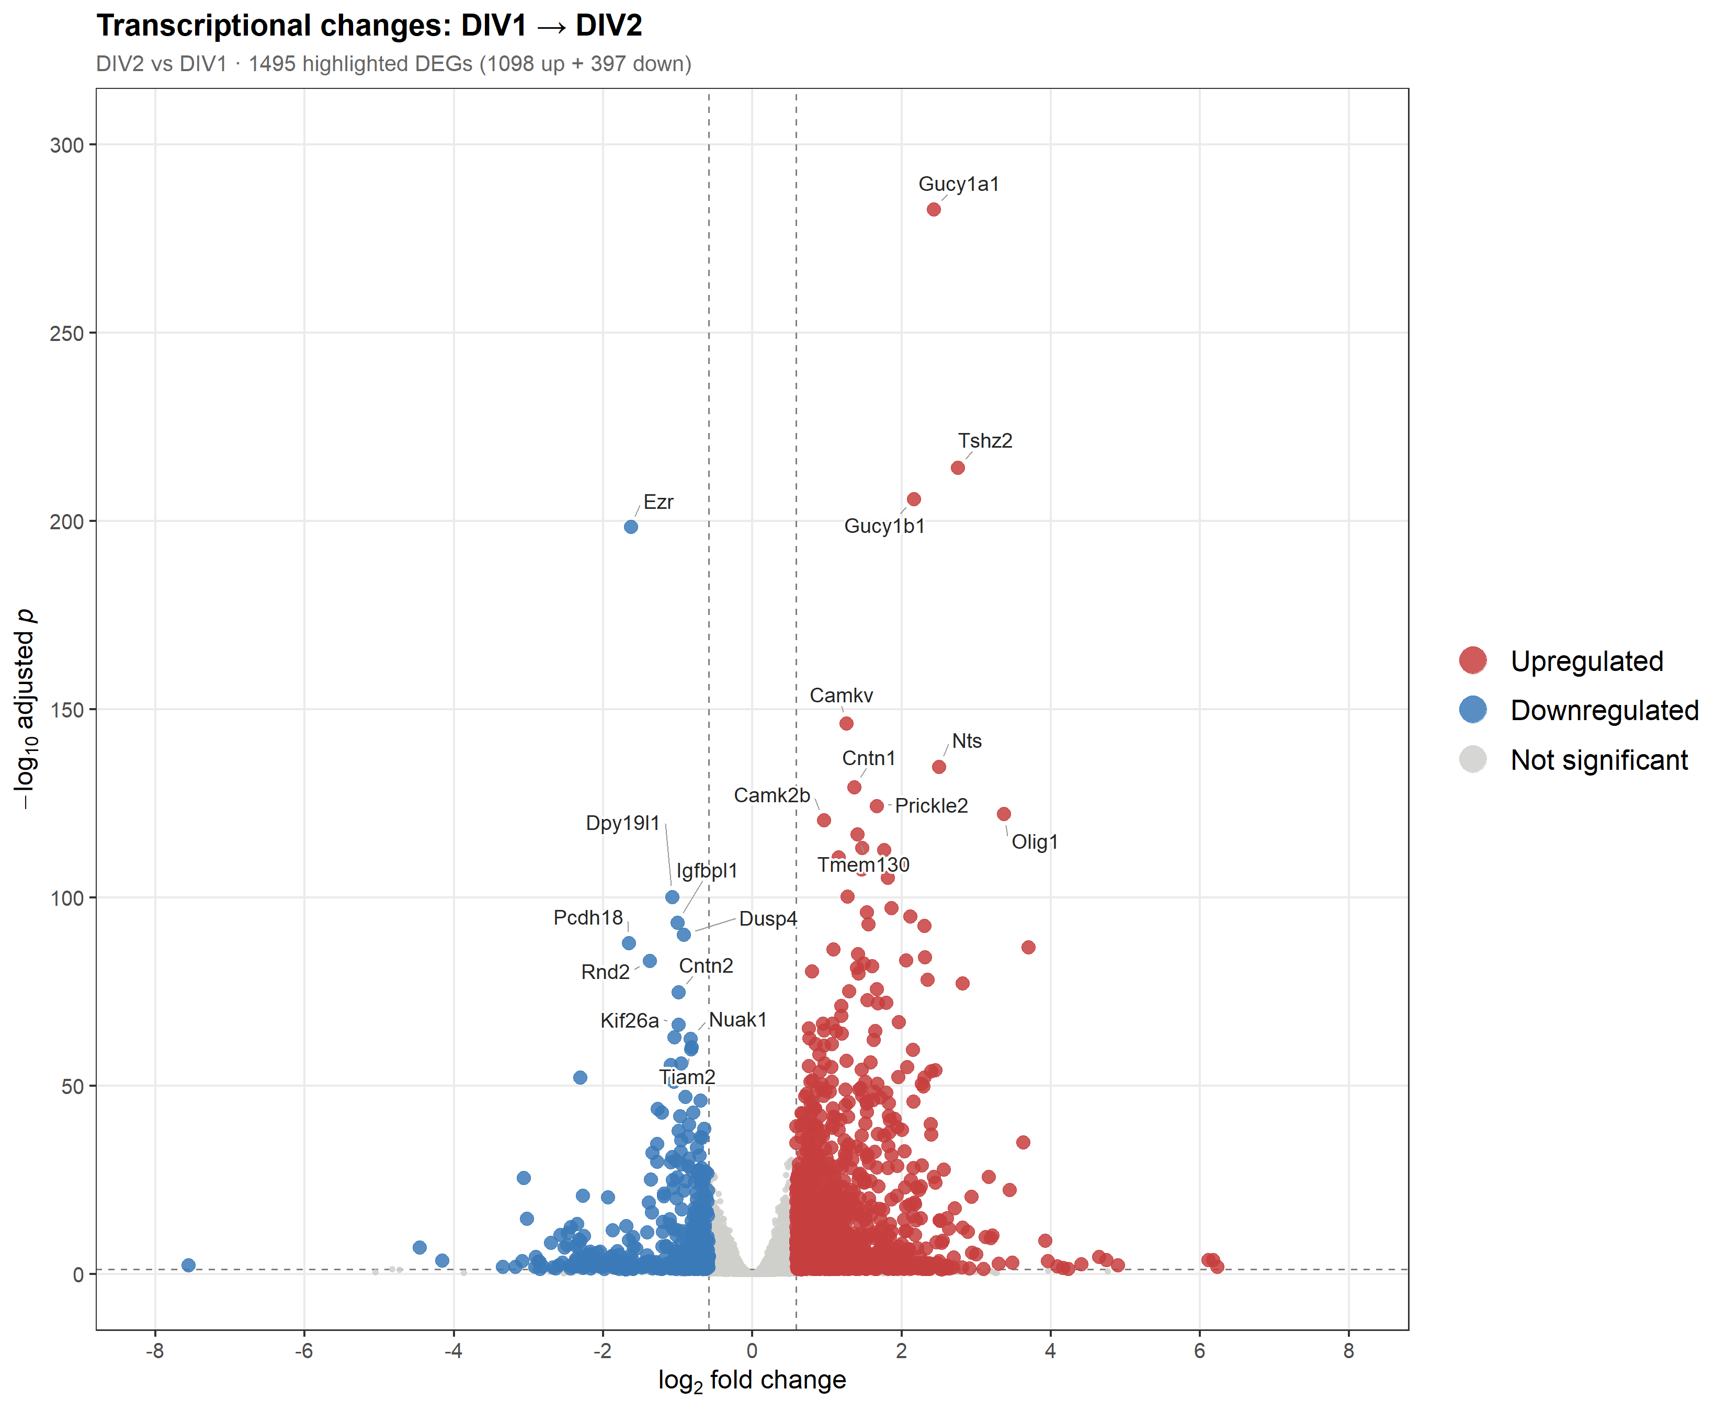
C2 DEG
Development dominates the transcriptome relative to Netrin treatment.
The secondary contrast is much larger than the primary contrast.
1,495
1,098 up / 397 down
strict DEGs
direction
4,636
relaxed DEGs
Olig1: +3.37 in C2 but -1.00 in C1, suggesting Netrin reverses part of natural induction.
Netrin-1 RNA-seq result update
12
Notes:
C2 火山图：STRICT 1495，RELAXED 4636，比 C1 大得多。这个对比说明发育/时间效应是主轴。Olig1 在 C2 上调但在 C1 下调，支持 Netrin 不是沿发育方向简单推进。

Slide 13
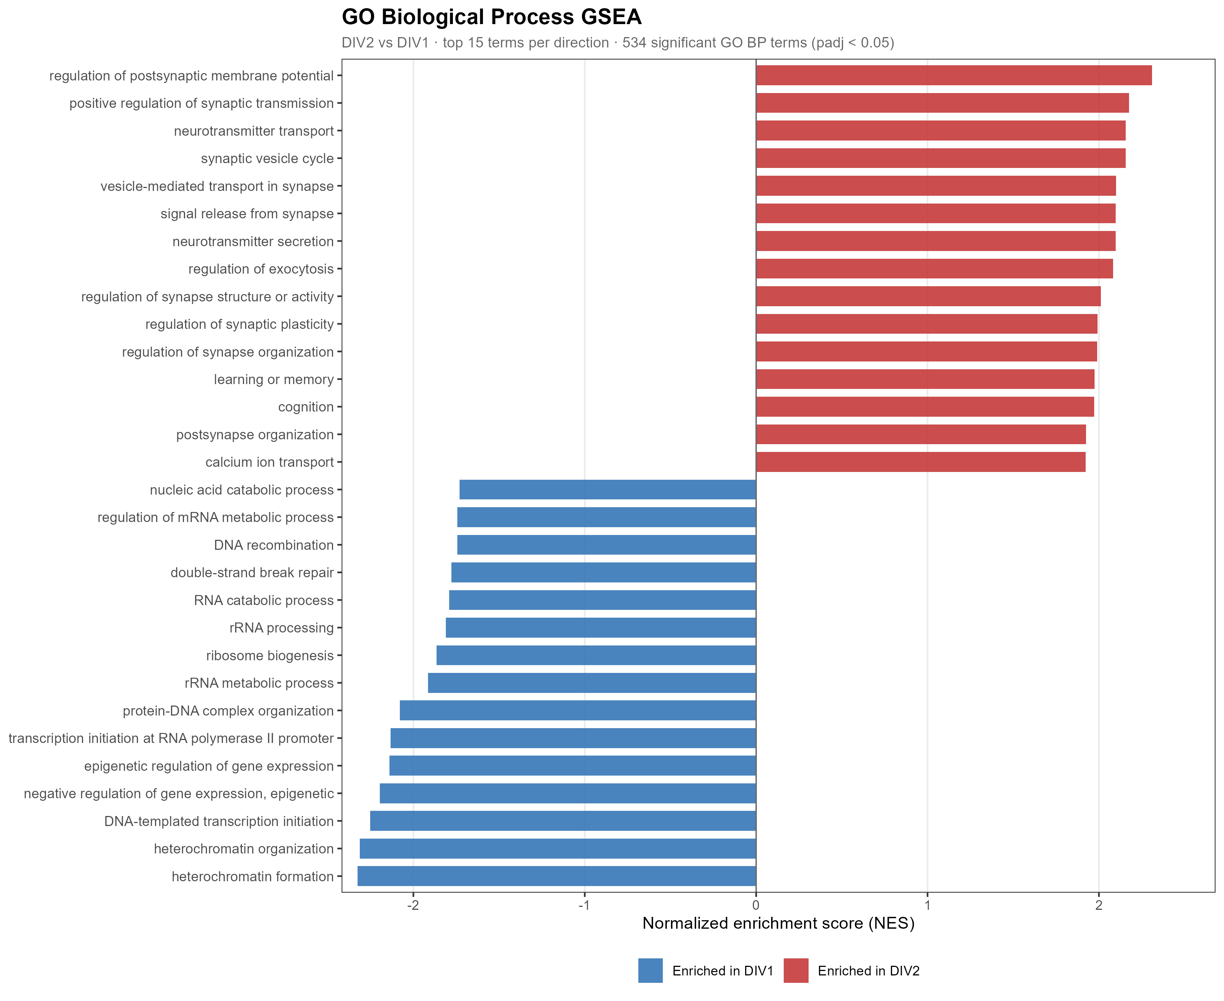
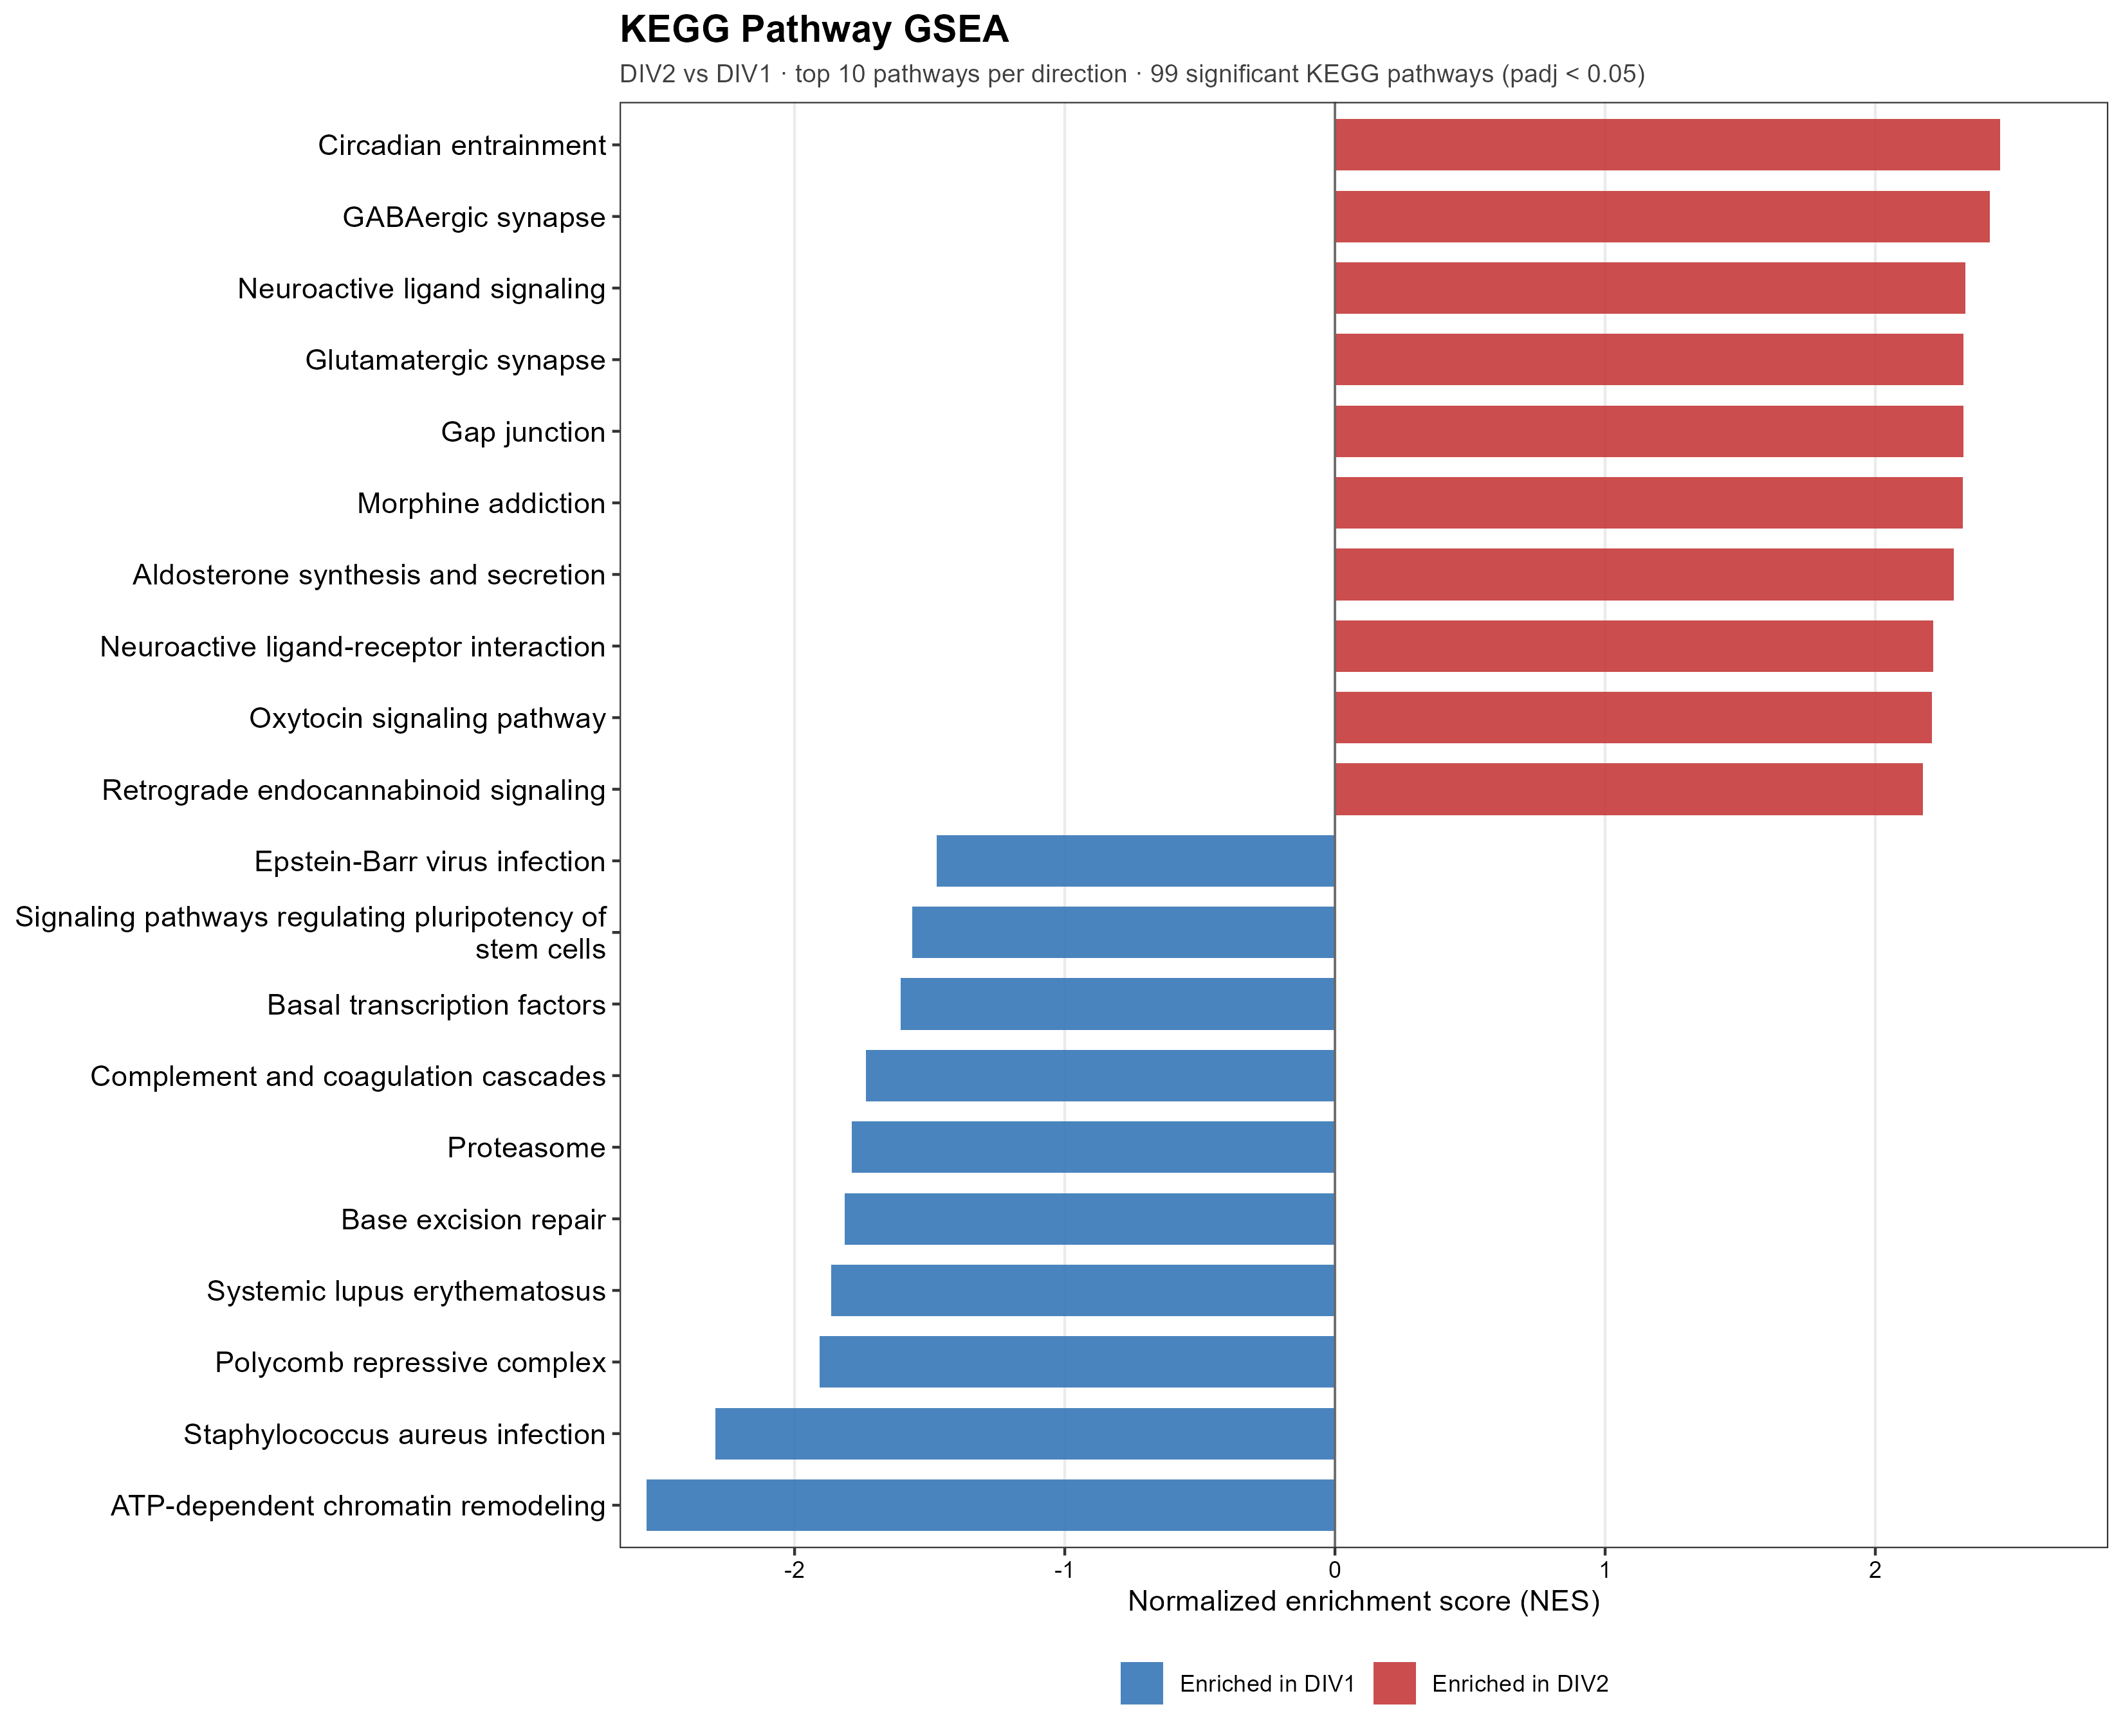
C2 PATHWAYS
DIV2 activates mature neuronal programs and suppresses precursor programs.
GSEA and ORA agree on the developmental interpretation.
GO BP: 534 significant terms (410 activated / 124 suppressed)
KEGG: 99 significant pathways (89 activated / 10 suppressed)
Netrin-1 RNA-seq result update
13
Notes:
C2 pathway 页。DIV2 富集突触传递、递质转运、可塑性、GABA/glutamate synapse；DIV1 富集染色质、核糖体、DNA 修复等前体程序。这是合理的发育成熟背景。

Slide 14
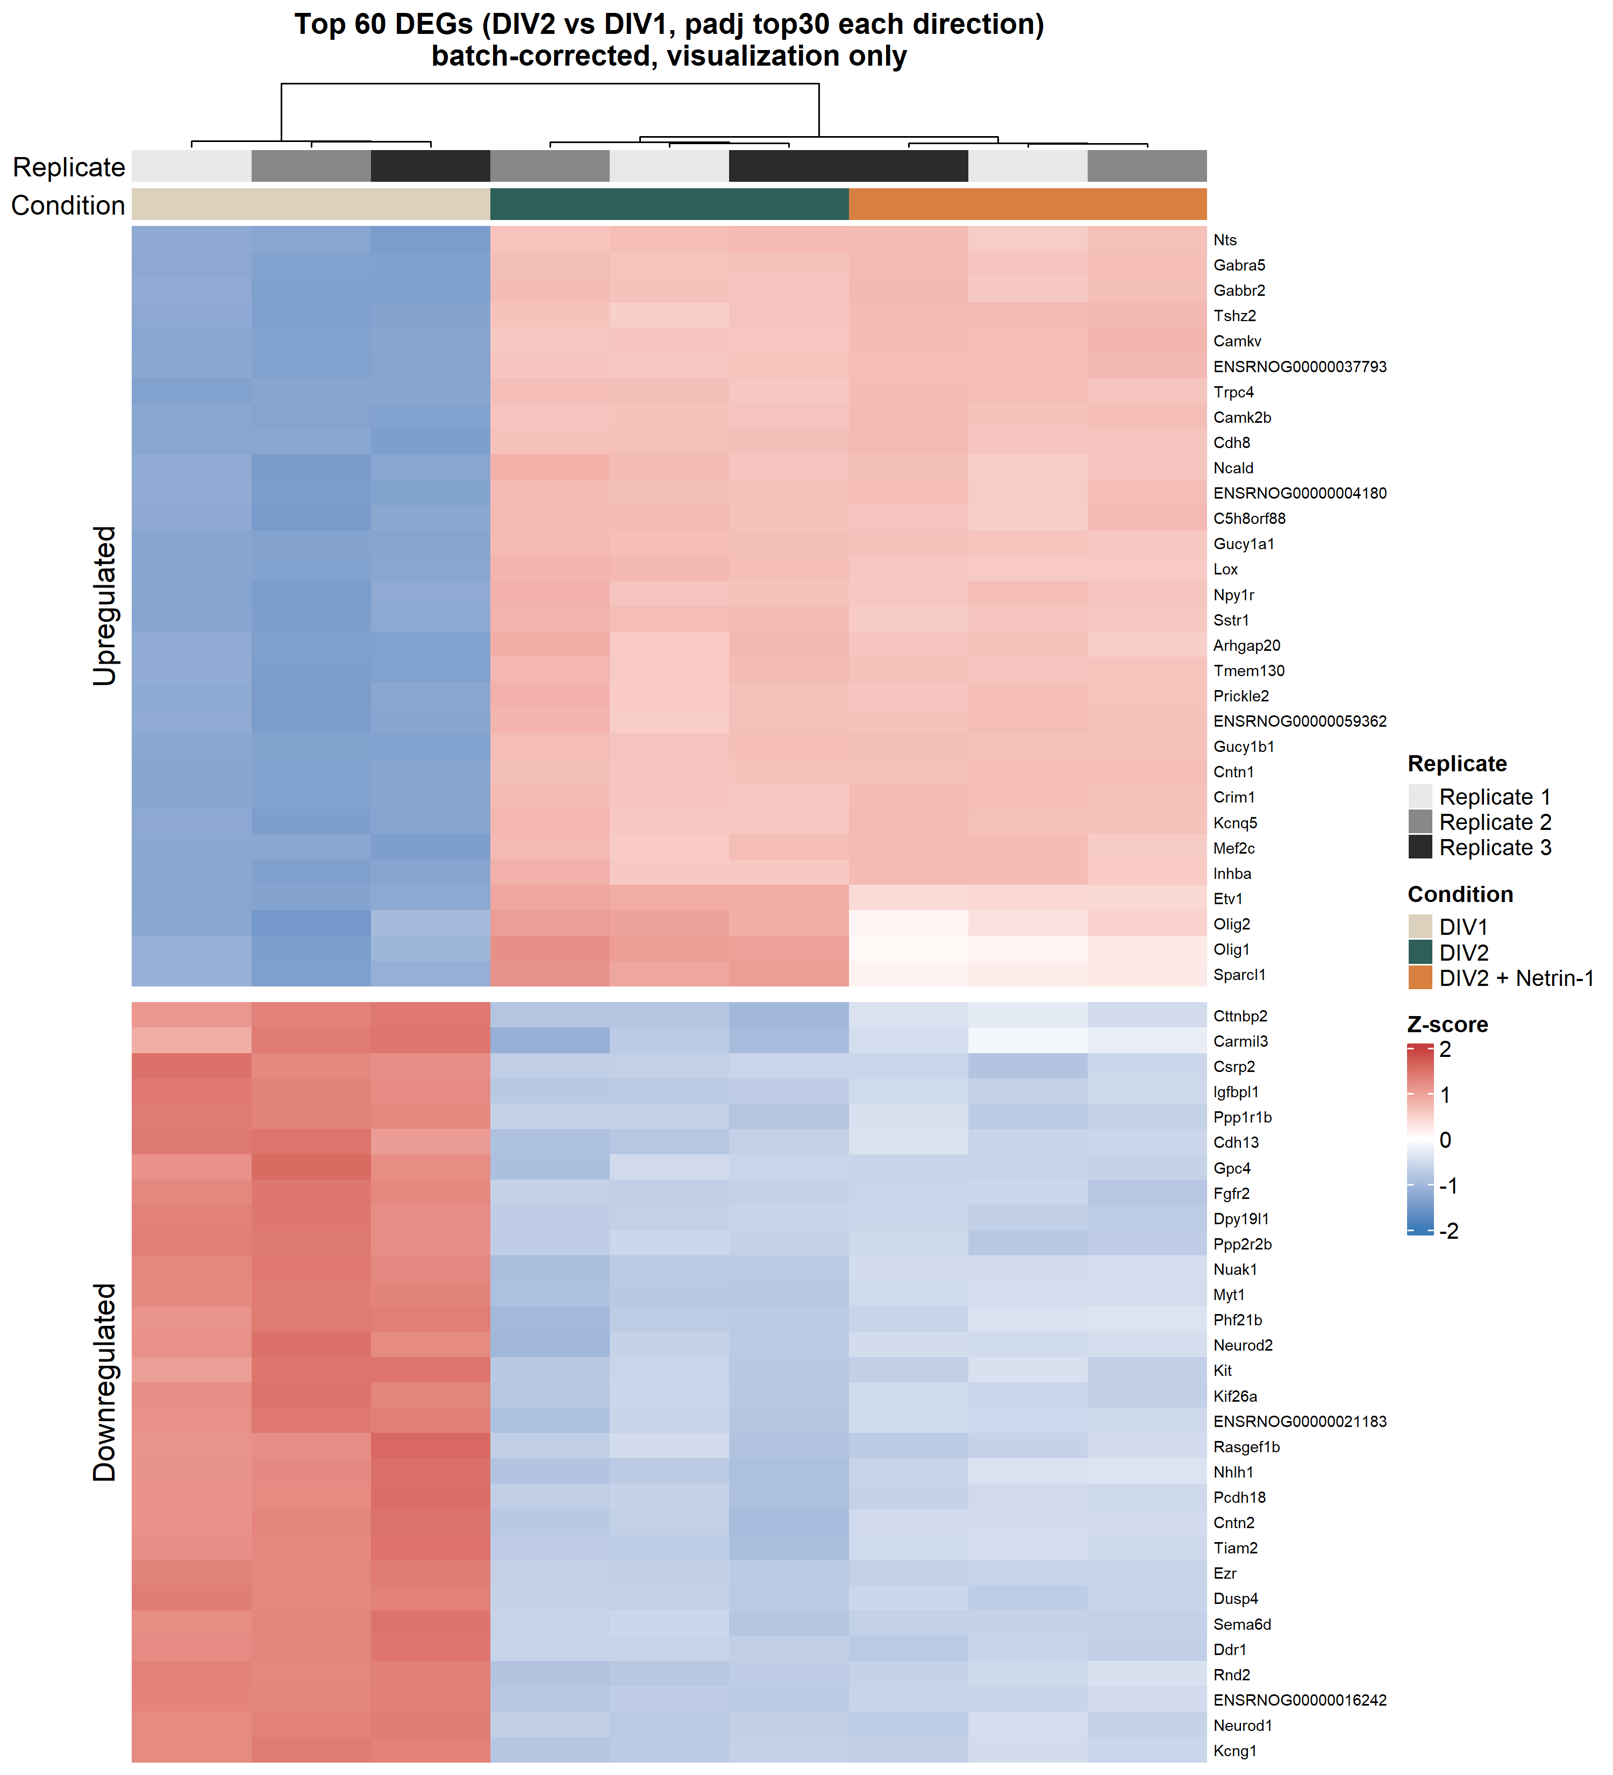
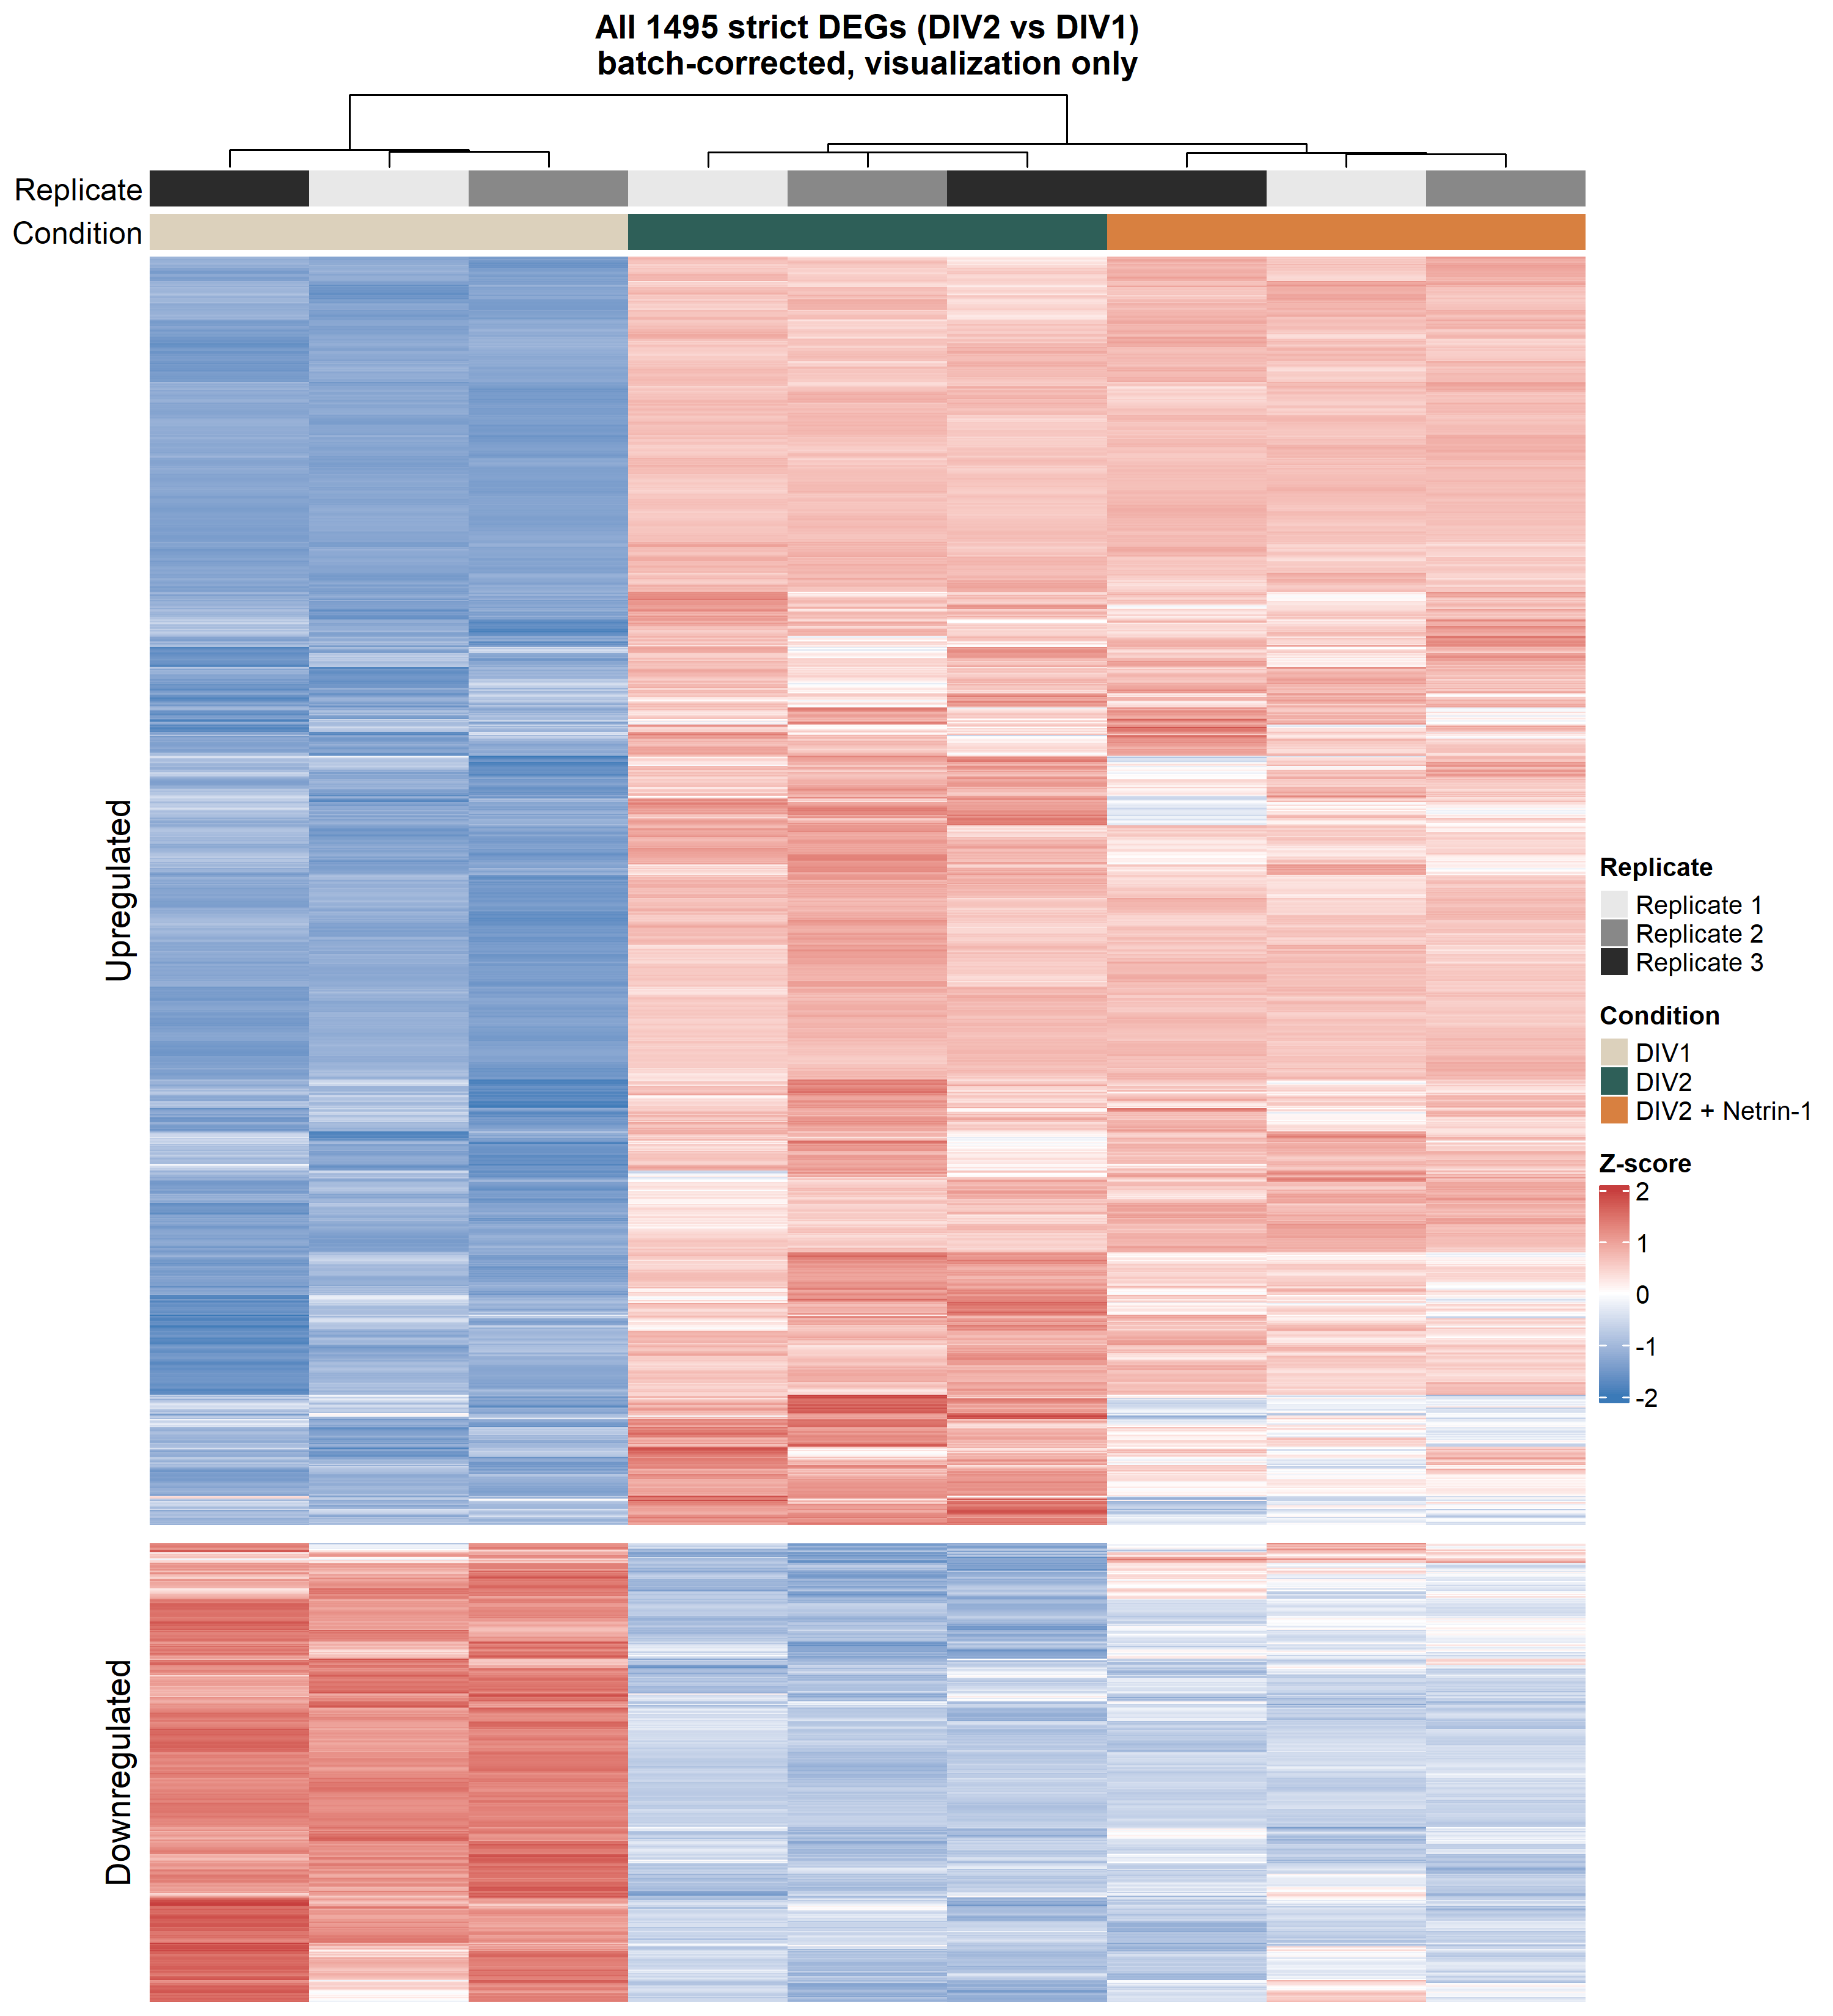
C2 STRUCTURE
Heatmaps show development is the dominant expression axis.
DIV1 separates from both DIV2 states; Netrin is a smaller perturbation within DIV2.
Top 60 strict DEGs
All 1,495 strict DEGs
Netrin-1 RNA-seq result update
14
Notes:
热图页：DIV1 独立，DIV2 与 DIV2+Netrin 更接近。说明发育主导整体结构，Netrin 是在 DIV2 状态上的较小扰动。

Slide 15
RESULT 3
Cell-type marker analysis changes how we read the bulk signal.
This is the interpretation guardrail.
15
Notes:
进入细胞来源分析。这里是组会上最值得讨论的部分。

Slide 16
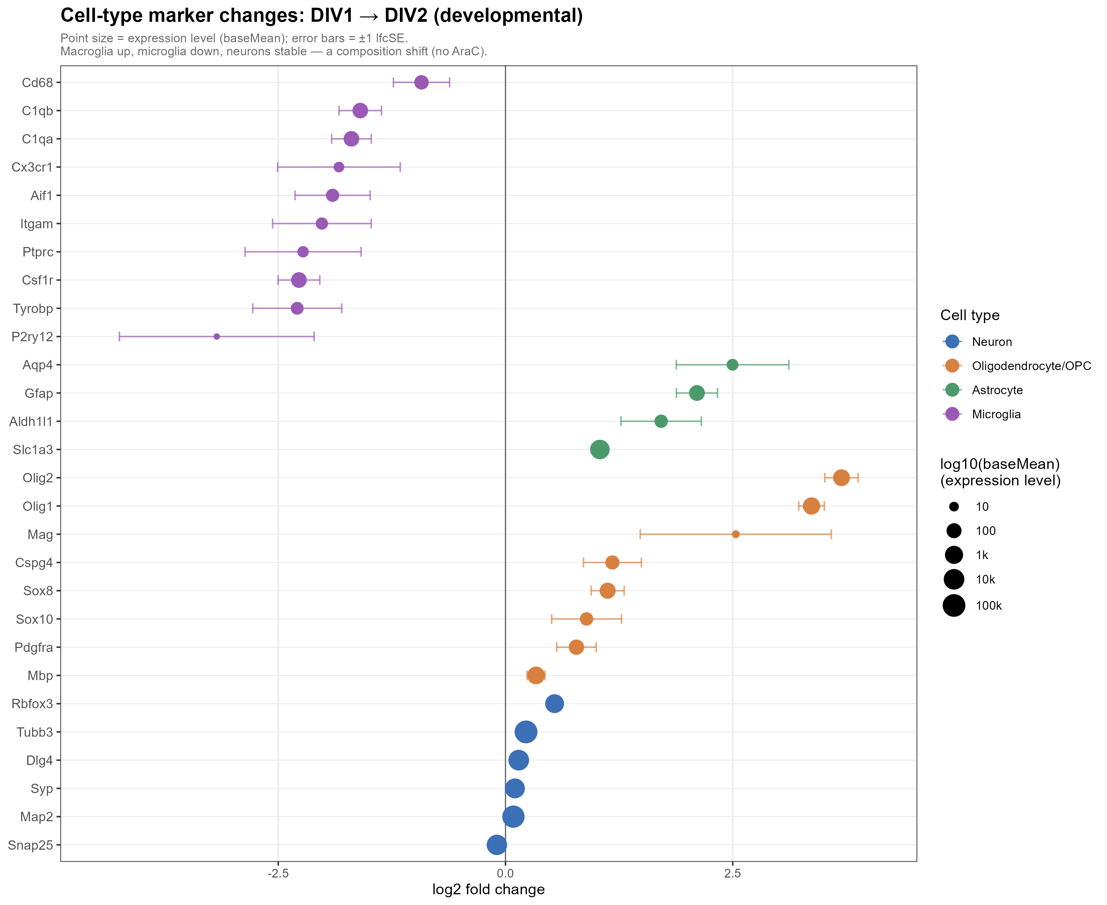
CELL-TYPE MARKERS
C2 contains a strong composition shift.
Macroglia / OPC markers rise; microglia markers fall; neuronal markers are relatively stable.
C2 reading
Many developmental DEGs likely reflect composition changes in mixed culture, not only neuron-intrinsic maturation.
No AraC mixed culture: marker behavior is inference, not direct cell counting.
Netrin-1 RNA-seq result update
16
Notes:
C2 marker 图：macroglia/OPC 和 astrocyte 相关 marker 上升，microglia marker 下降，neuron marker 近似稳定。这个结果提示 C2 的大量 DEG 包含细胞组成变化。

Slide 17
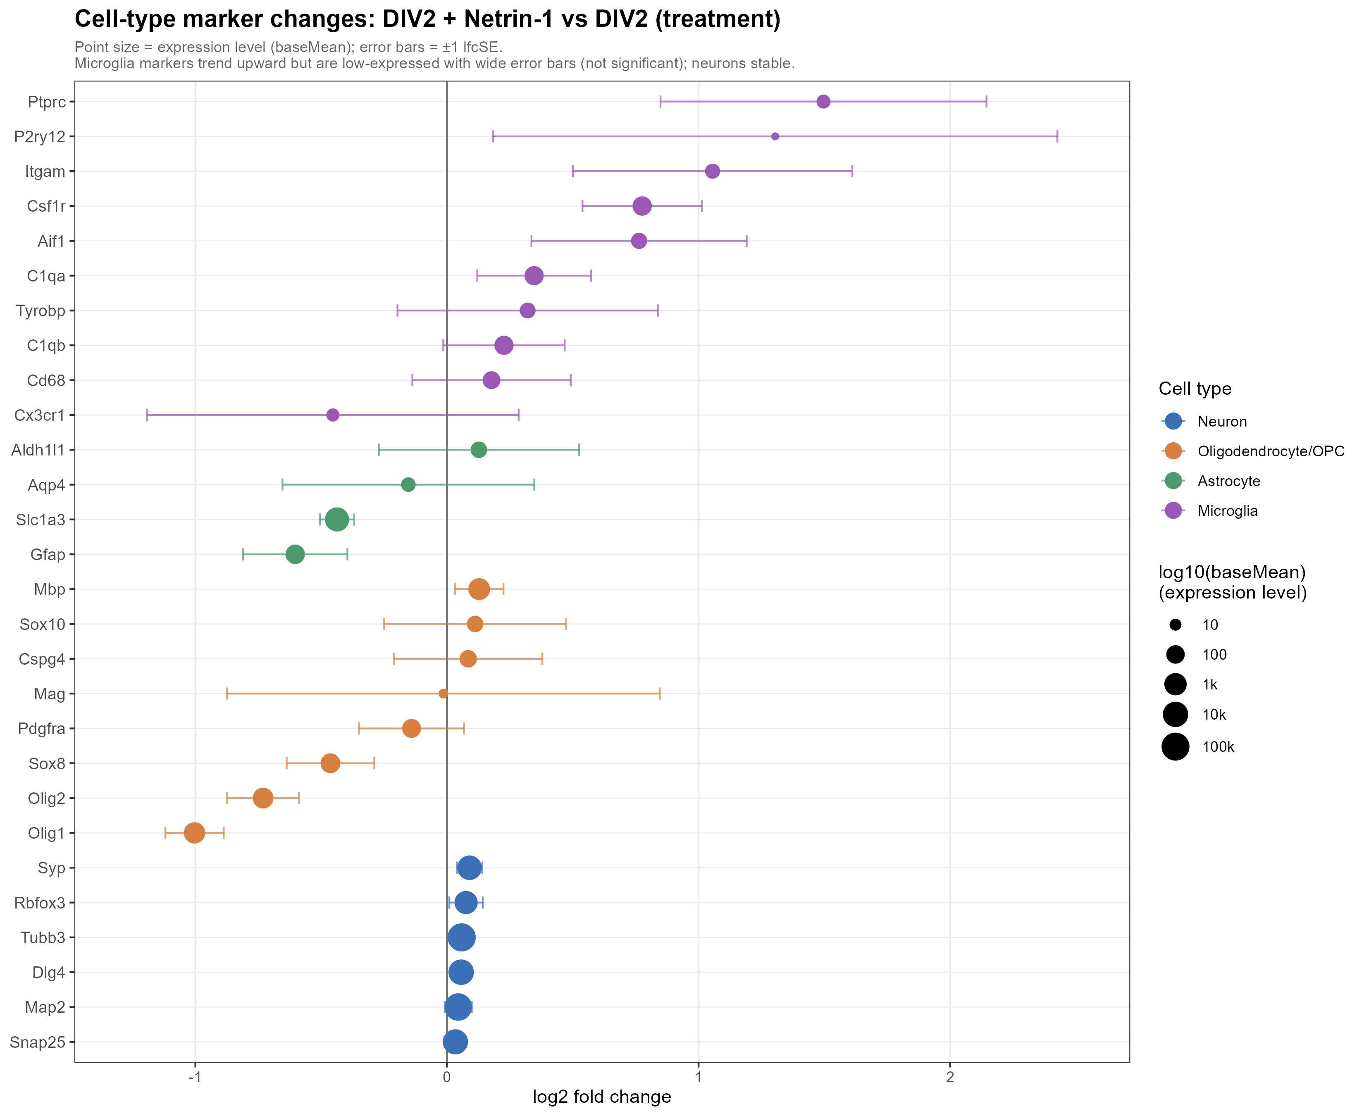
CELL-TYPE MARKERS
C1 does not show the same composition collapse.
Microglial effect genes rise, while identity markers are mostly trends with wide uncertainty.
C1 reading
Immune genes are consistent with microglial activation, but identity markers do not prove a large increase in microglia number.
Preferred wording: “consistent with microglial activation,” not “Netrin directly activates microglia.”
Netrin-1 RNA-seq result update
17
Notes:
C1 marker 图：效应基因如 C3/Apoe 等显著，但 microglia 身份 marker 多为趋势并且误差大。因此最好说 consistent with microglial activation，而不是直接说 Netrin activates microglia。

Slide 18
WORKING MODEL
Netrin-1 has a direct neuronal axis and an indirect/source-limited immune axis.
This framing keeps the result strong without over-claiming causality.
Cortical neurons
Exogenous
Netrin-1
direct
Neo1 / Dcc / Dscam / Unc5a
indirect?
Microglia
C3 / Apoe / Ncf1
Synapse / axon guidance
Main point
Use neuronal pathways as the confident axis; treat immune signals as source-limited.
Netrin-1 RNA-seq result update
18
Notes:
工作模型页。神经元轴最可靠：受体丰富，axon guidance/synapse 通路上调。免疫轴是真实信号，但来源和因果有限，可能是神经元介导的间接 microglia activation。

Slide 19
SYNTHESIS
Netrin fine-tunes; development activates broadly.
The two contrasts have different scale and direction balance.
activated
suppressed
410
89
255
226
22
20
124
10
C1 GO
C2 GO
C1 KEGG
C2 KEGG
Interpretation
C1 is balanced and bidirectional; C2 is activation-skewed. This supports Netrin as tuning rather than broad developmental acceleration.
Netrin-1 RNA-seq result update
19
Notes:
整合页。C1 的 GO/KEGG 基本双向平衡；C2 明显偏激活。这一页把主结论落稳：development 是大规模 activation，Netrin 是双向微调。

Slide 20
TAKEAWAYS / NEXT STEPS
What I would discuss today.
The result is mature enough to decide the next validation experiments.
Takeaway 1
Takeaway 2
Netrin-1 produces a focused 24 h transcriptional response: 25 strict DEGs, 66 relaxed DEGs.
GSEA reveals two coordinated modules: synapse / axon guidance up, cell-cycle / progenitor down.
Takeaway 3
Next decisions
Cell-type markers show why bulk interpretation must separate direct neuronal and indirect microglial signals.
Prioritize: scRNA-seq or sorted populations; IHC for microglia/composition; receptor perturbation; LPS/TLR controls.
Group discussion prompt: which validation path is the fastest route to a defensible mechanism?
Netrin-1 RNA-seq result update
20
Notes:
最后页。建议把讨论引向下一步：如果资源有限，哪个验证路线最快把模型变成机制？单细胞/分选解决来源，IHC 验证 marker，受体扰动验证直接依赖，LPS/TLR 控制排除免疫污染。

Slide 21
BACKUP
Additional result slides for questions.
ORA and heatmap evidence kept at the end.
21
Notes:
备份页开始。正式组会可以不讲，问到 ORA 或热图细节时再用。

Slide 22
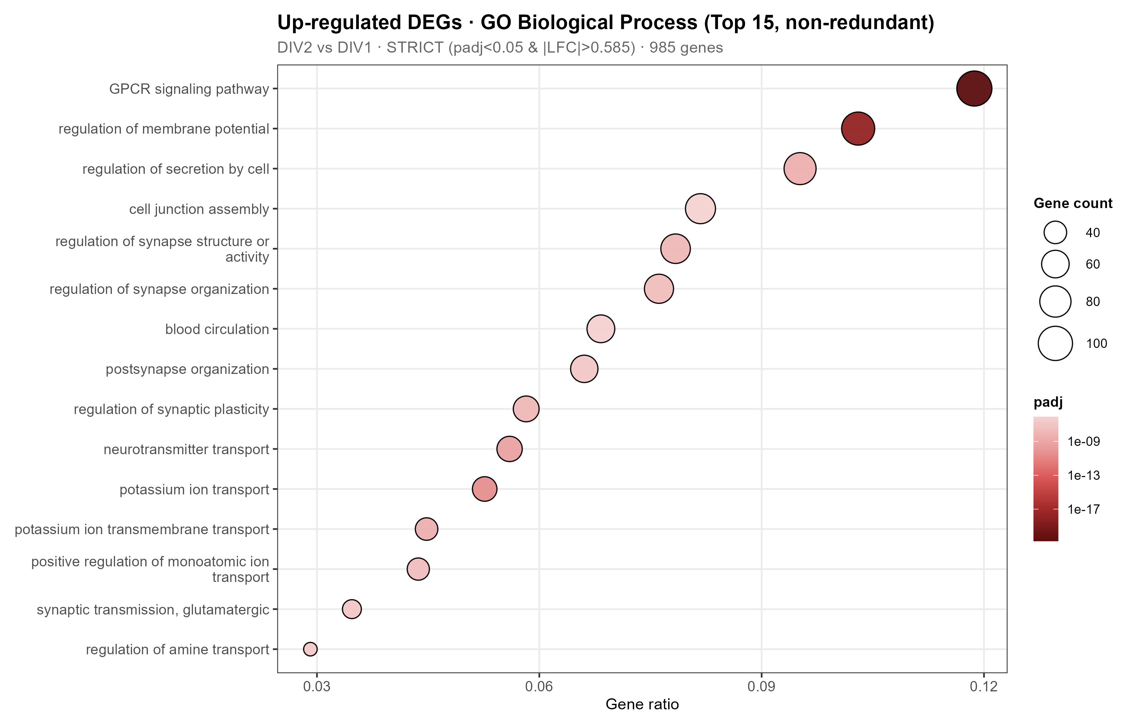
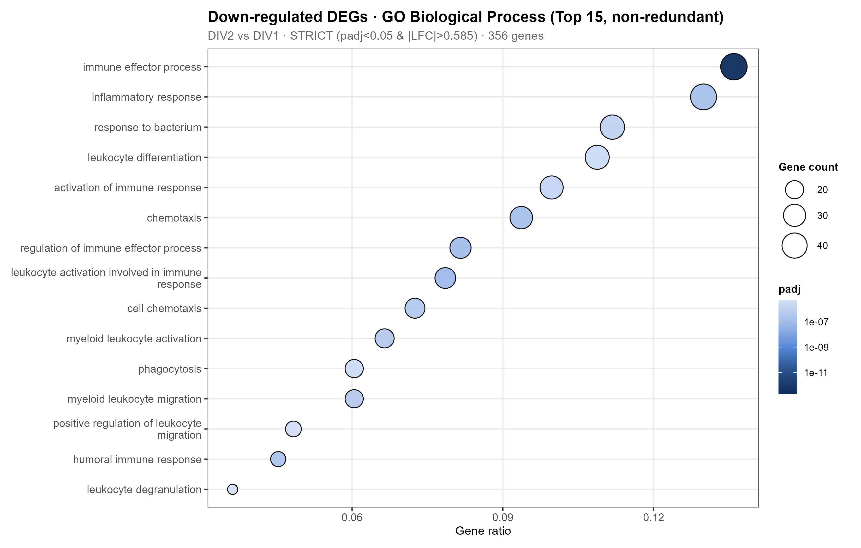
BACKUP: C2 ORA GO BP
ORA confirms neuronal maturation up and immune/progenitor programs down.
Strict DEG input; GO terms simplified at cutoff 0.7.
Netrin-1 RNA-seq result update
22
Notes:
备份 ORA GO。输入是 C2 strict DEG 的 entrez 子集：up 985、down 356；GO simplify 后 up 160、down 91。

Slide 23
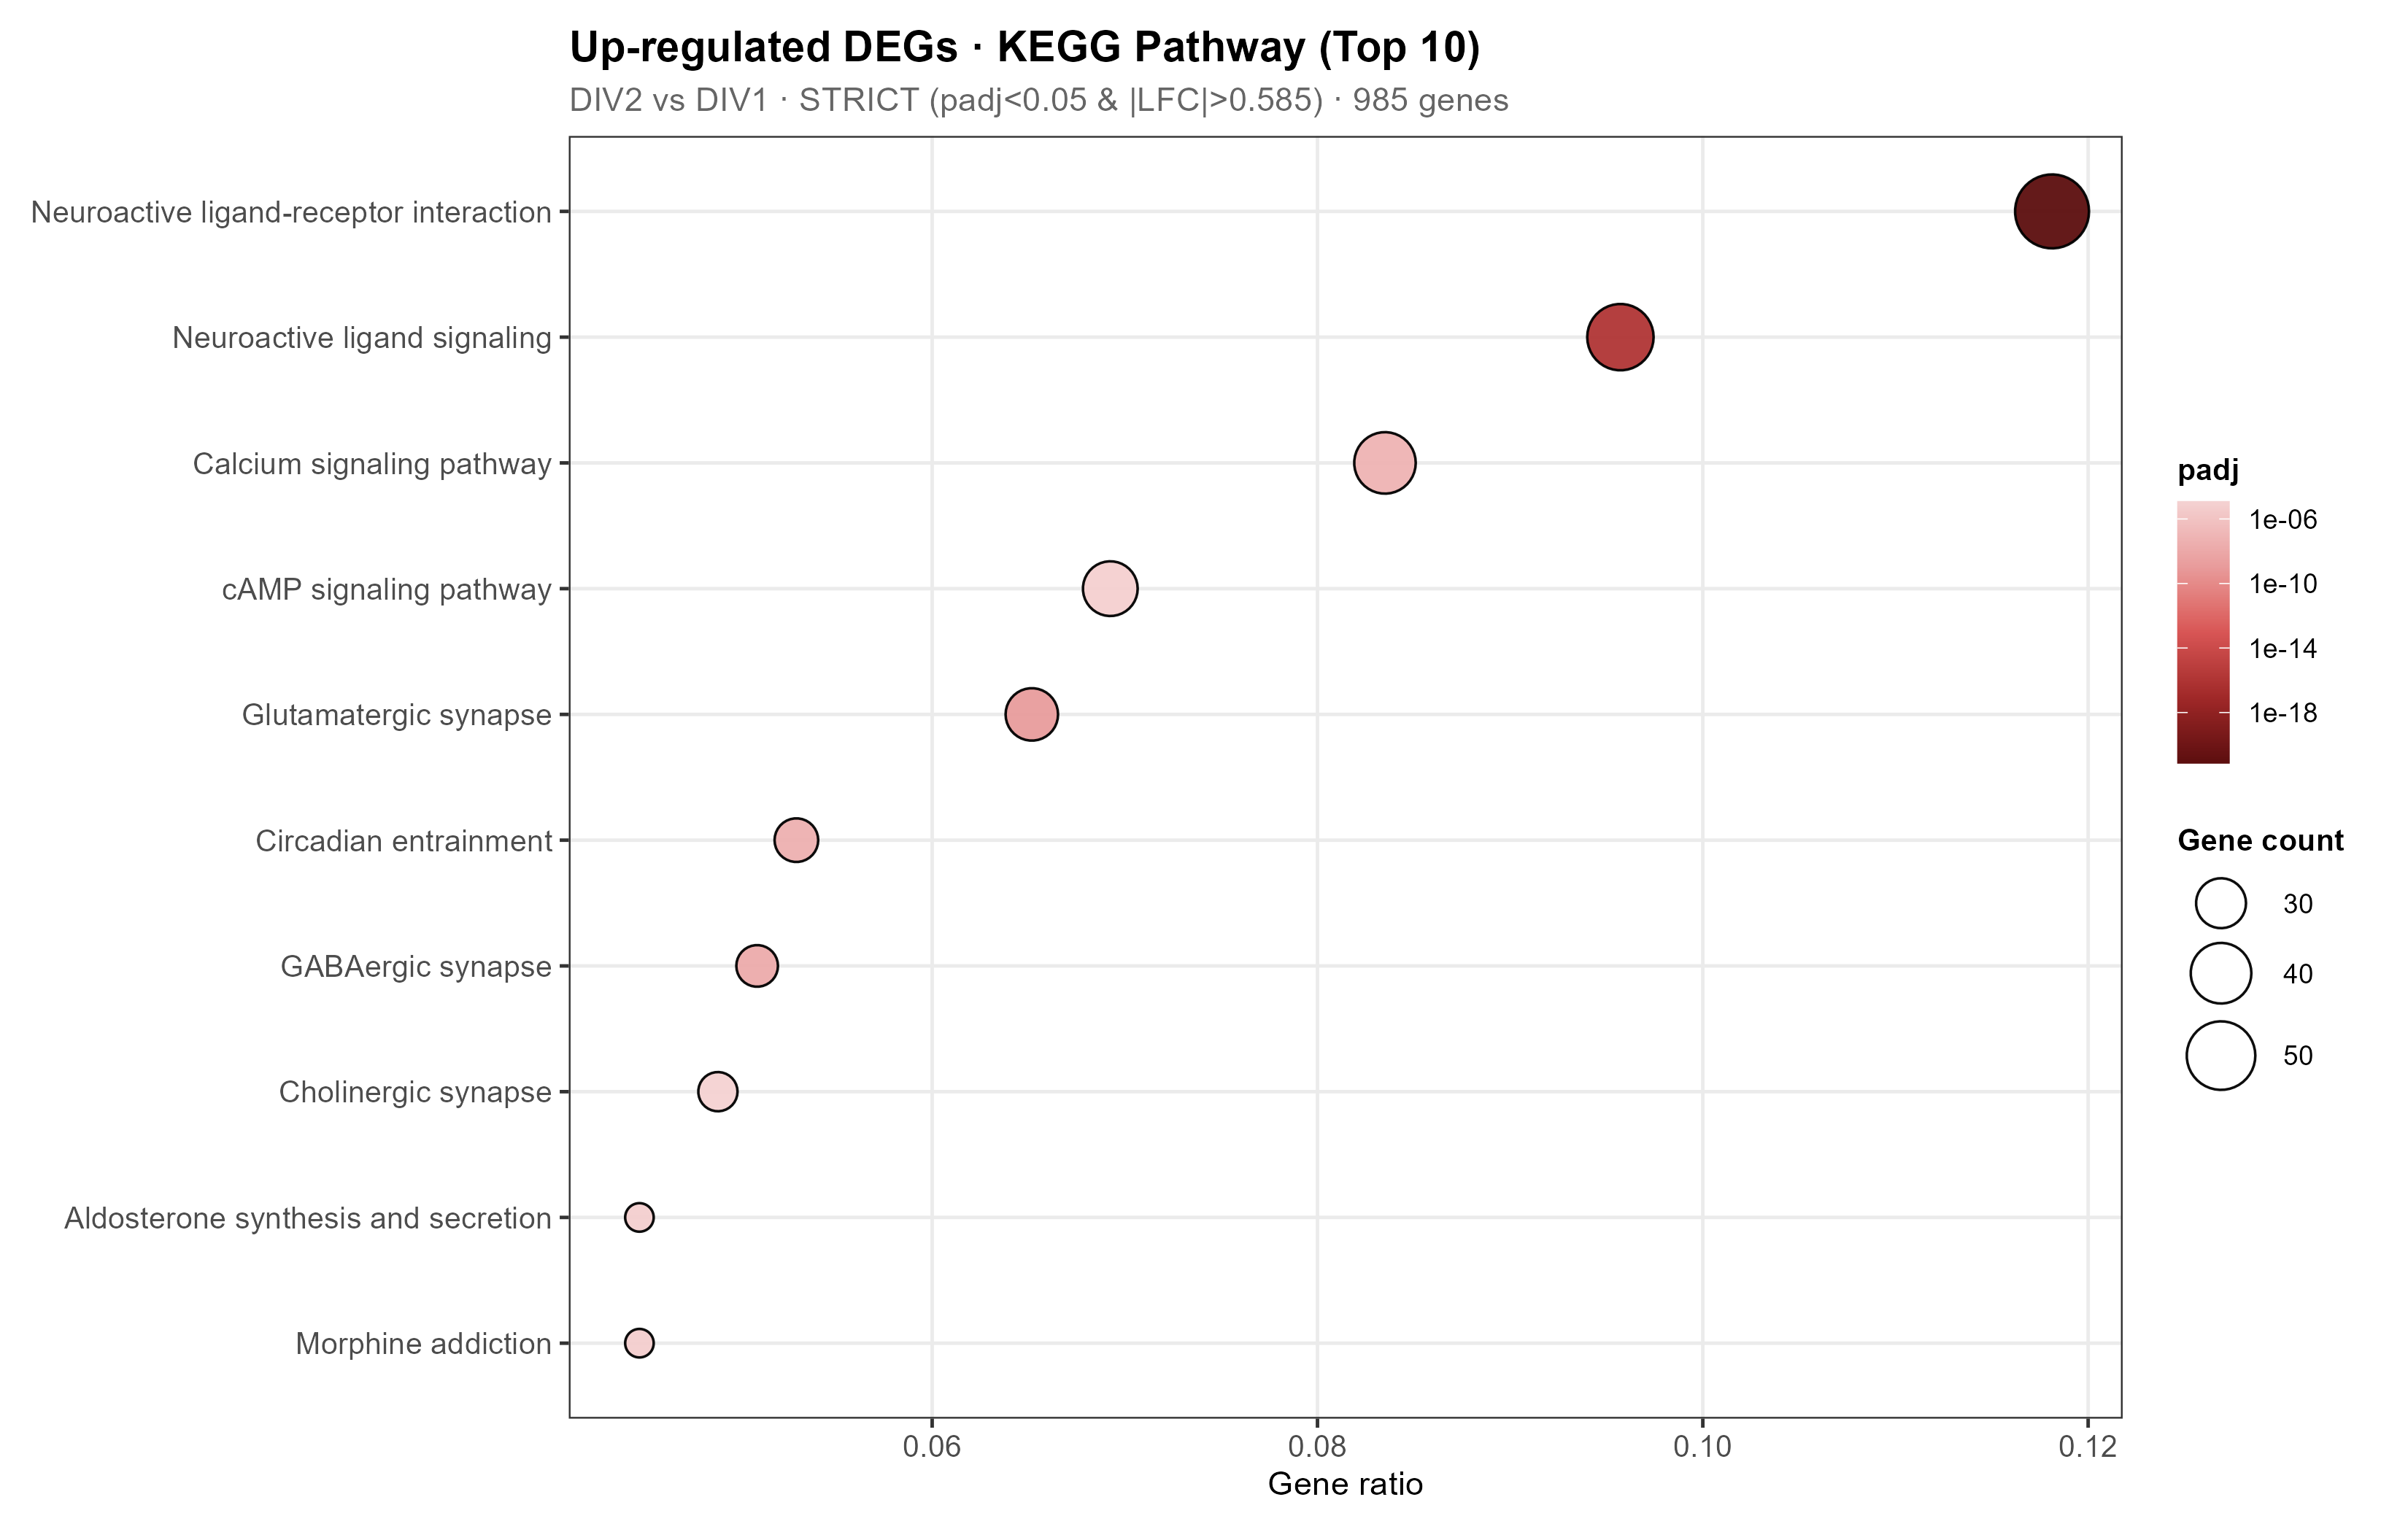
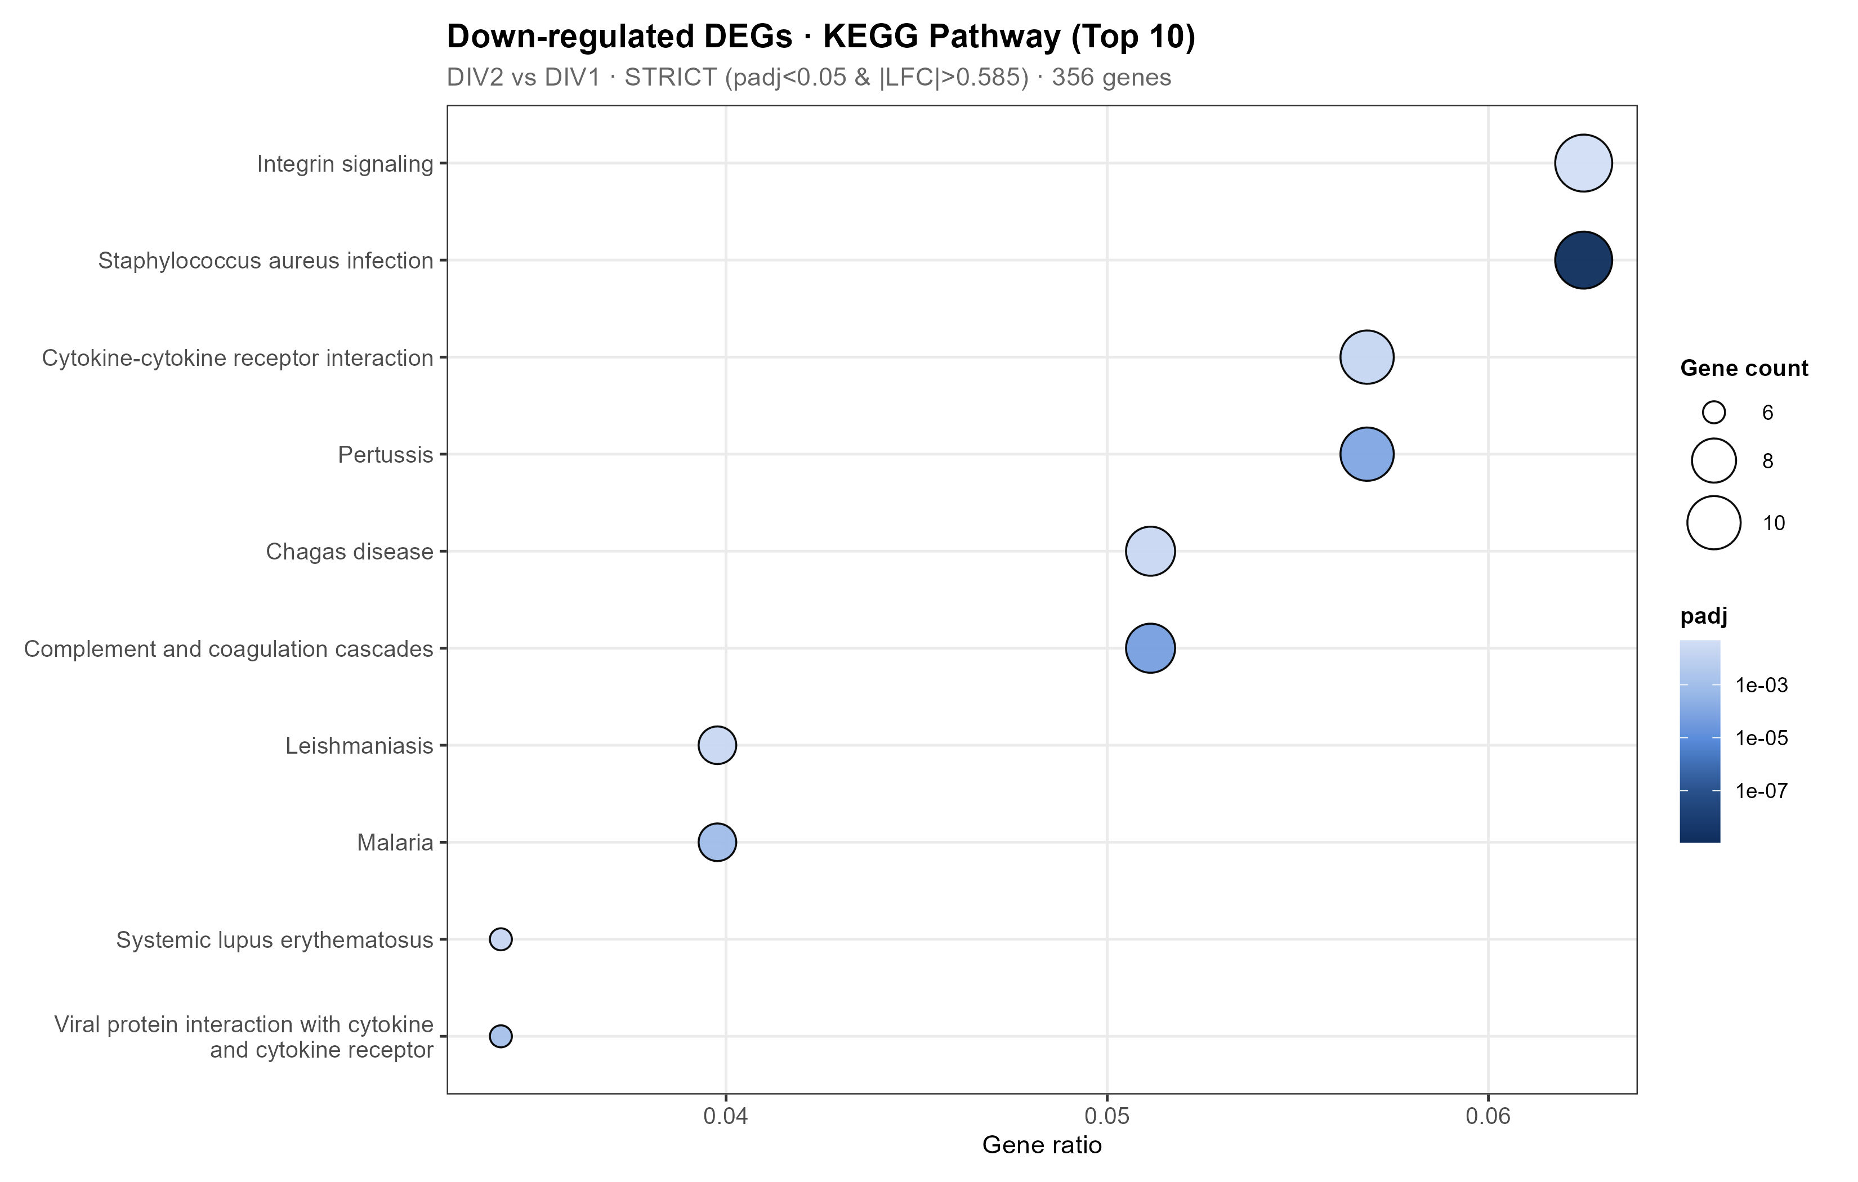
BACKUP: C2 ORA KEGG
KEGG ORA provides pathway-level context for development.
Disease-named KEGG terms are interpreted as shared immune machinery, not disease states.
Netrin-1 RNA-seq result update
23
Notes:
备份 KEGG ORA。注意 KEGG disease-name caveat：不是疾病状态，而是共享免疫/补体/感染相关机制。

Slide 24
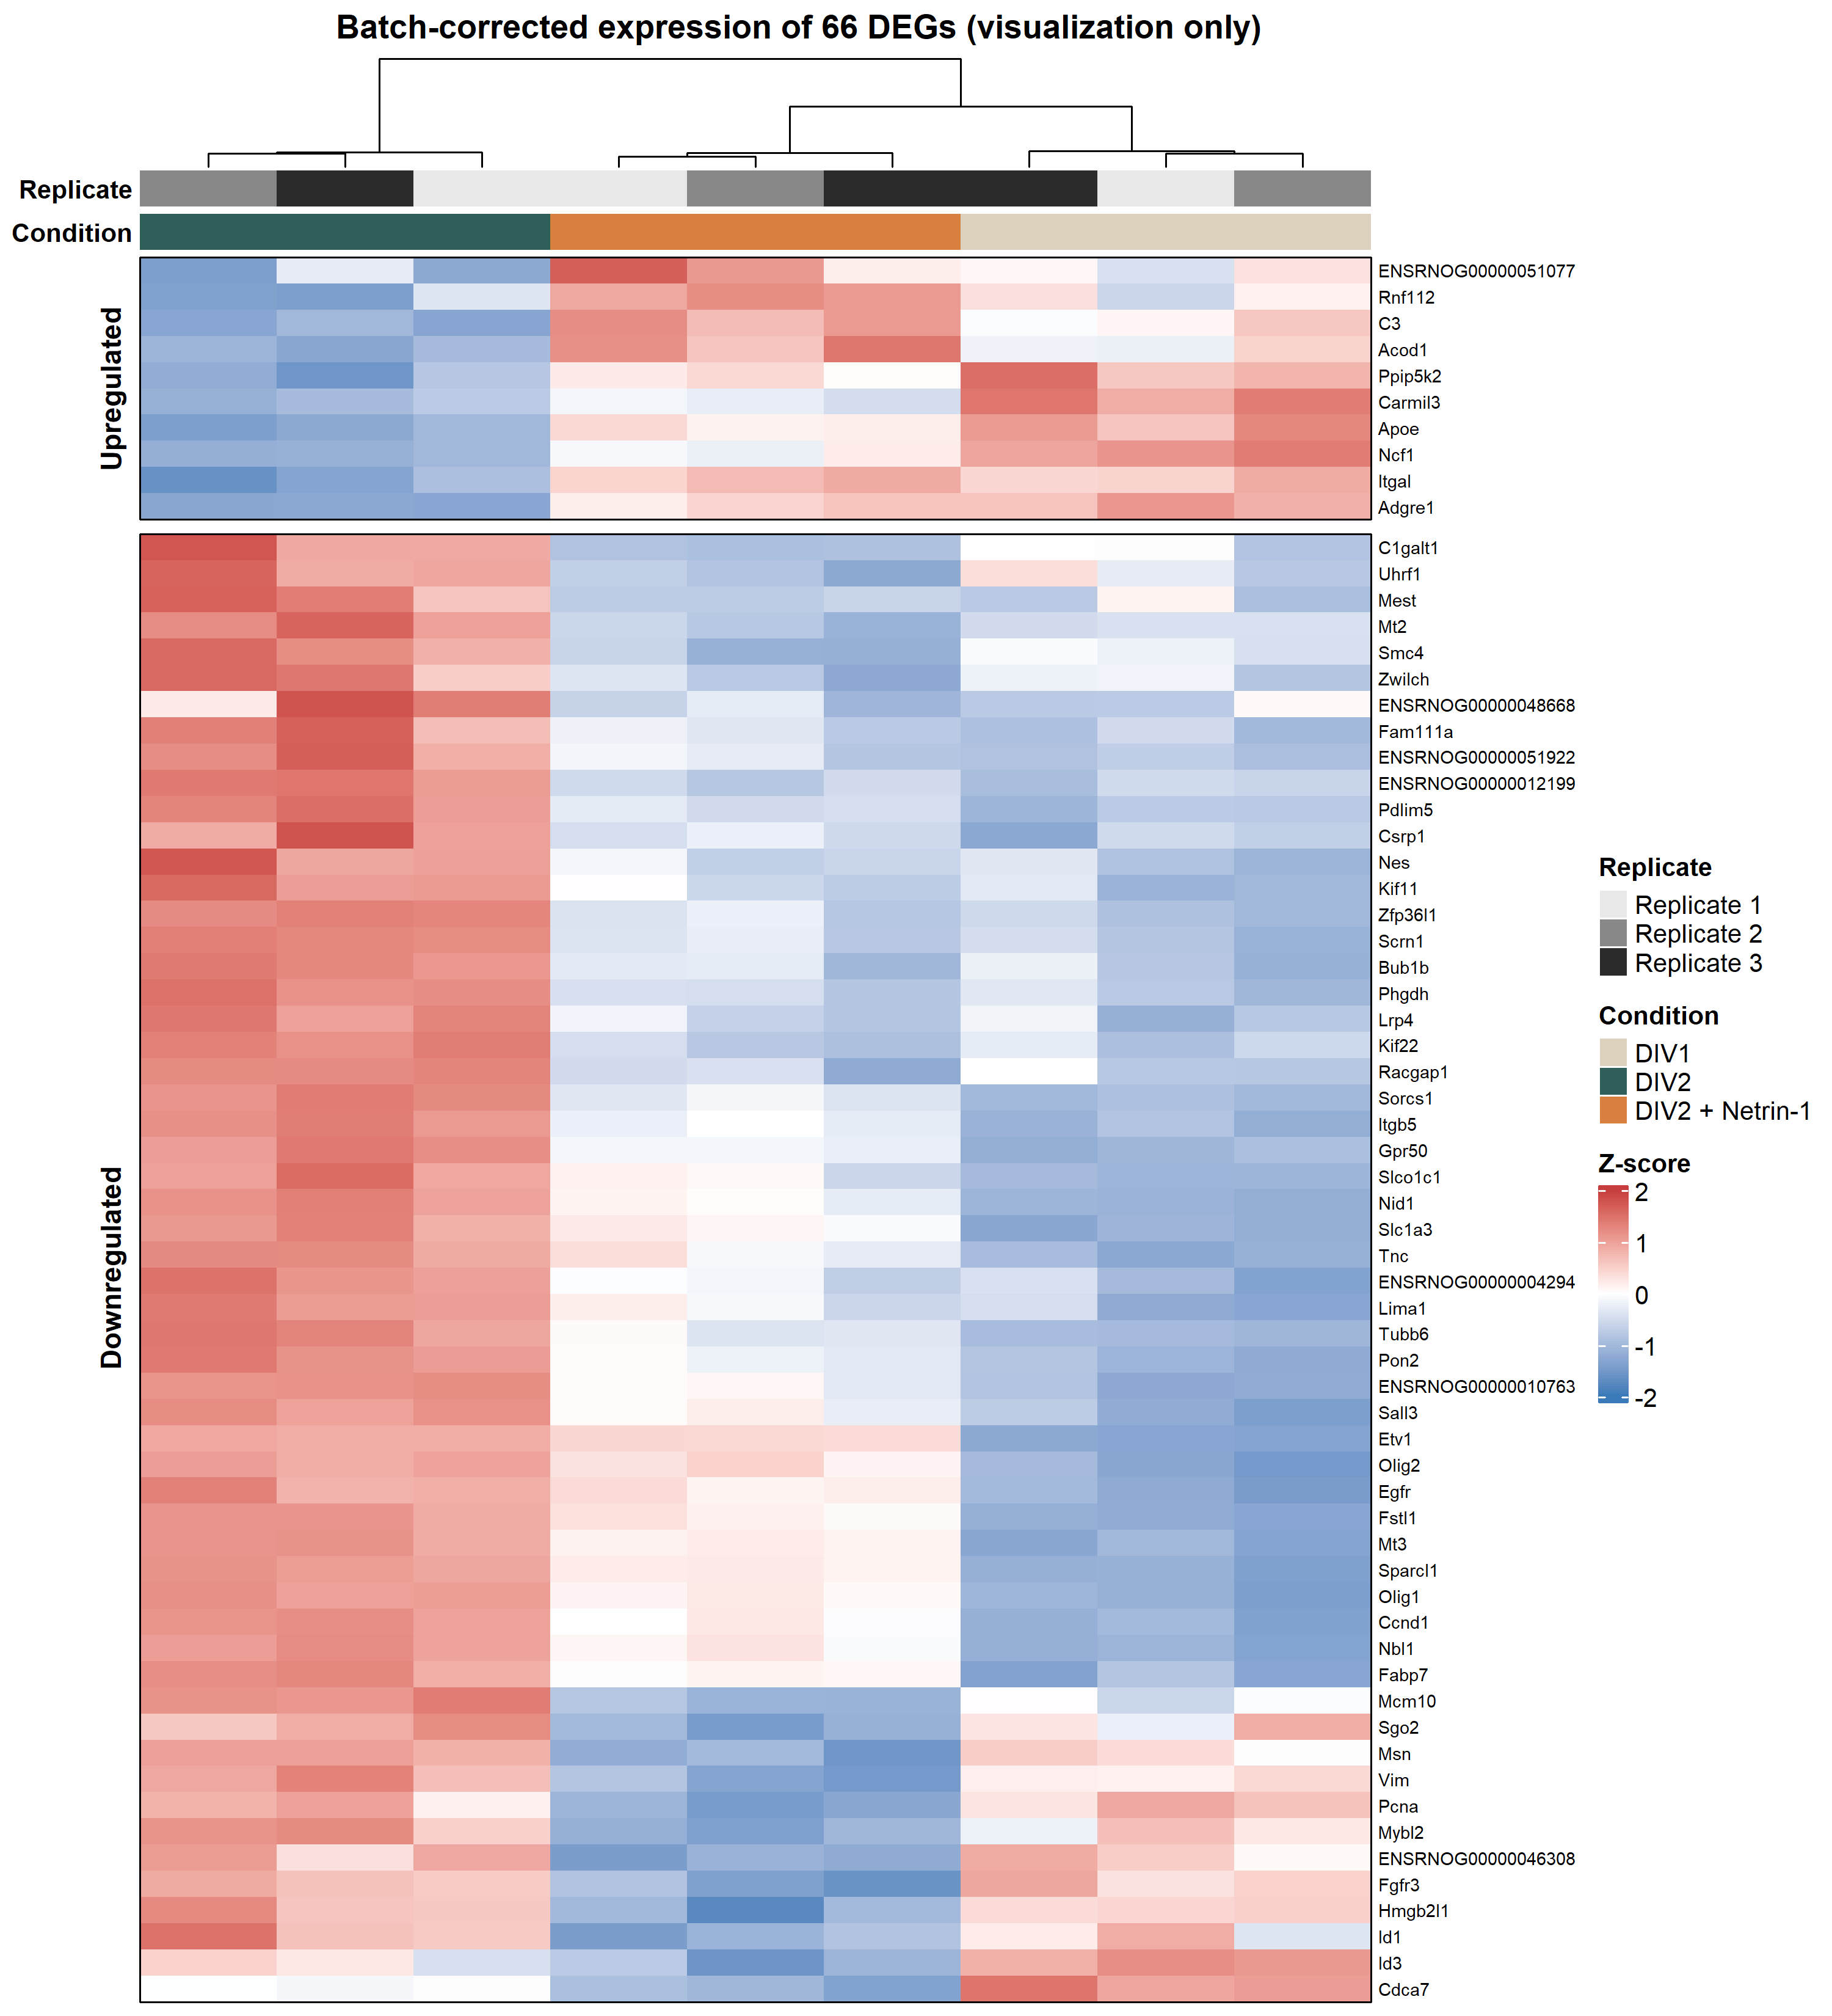
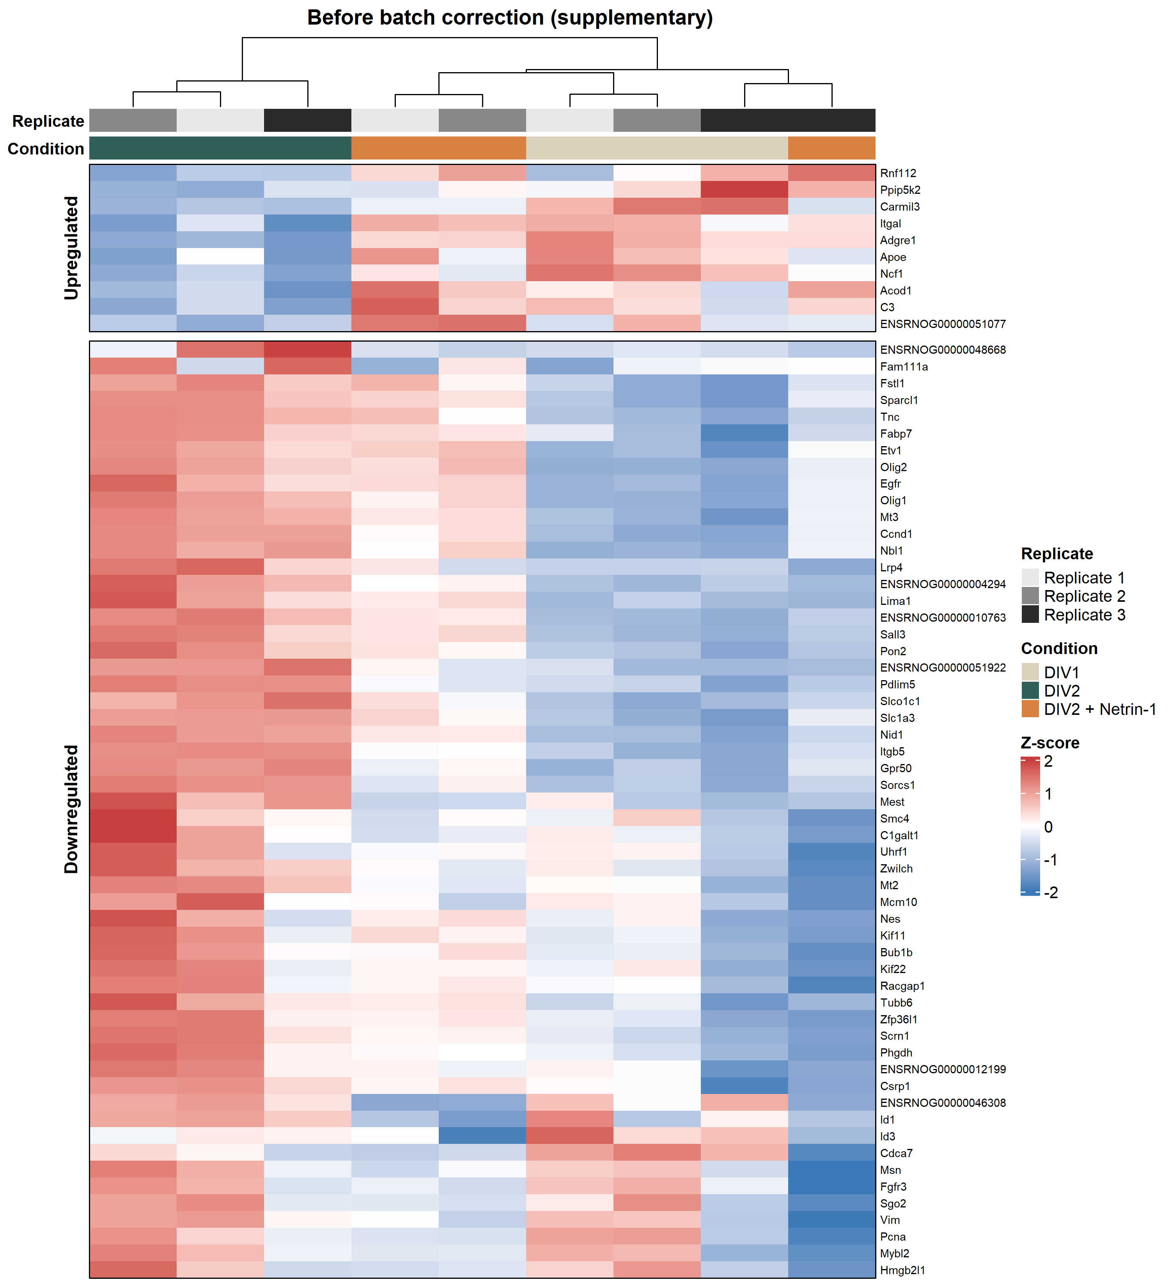
BACKUP: C1 RELAXED DEG HEATMAP
The two-module structure is visible in both corrected and raw VST views.
Batch correction is visualization-only; statistical testing remains on original counts.
Netrin-1 RNA-seq result update
24
Notes:
备份 C1 heatmap。可用于回答 batch correction 影响；主图和 raw VST 都能看到两模块结构。

